Slide 1
Principles of International Finance and Open Economy Macroeconomics
Cristina Terra

Slide 2
Chapter 9
Currency Crises
Cristina Terra

Slide 3
Introduction
Currency crisis, or balance of payment crises = excessive exchange rate (ER) variations or pressure on the ER not explained by underlying economic variables.
The explanations for the currency crises are divided into three generations of models.
Each generation was developed to explain issues that were either not present or not important in preceding crises.
  Each currency crisis can have elements of more than one generation.

Slide 4
Introduction
First generation: developed in the 1980s.
  government fiscal policy incompatible with the fixed ER regime => continuous loss of reserves to maintain the exchange rate parity
  Focus: the role of the speculative attack as an arbitrage of asset prices
Second generation: based on the 1991-1993 EMS crisis.
  the choice of governments to defend or not ER parity
  cost to defend depends on the expectations of ER depreciation
  Focus: the role of expectations as a trigger to set off a crisis
Third generation: late 1990s
  Emphasis: the fragility of firms and banks balance sheets.

Slide 5
Plan
The Speculative Attack as Asset Price Arbitrage
Crises as Self-Fulfilling Prophecies
The Role of Banks and Foreign Debt
Contagion

Slide 6
The Speculative Attack as
Asset Price Arbitrage
Speculative attack = massive purchase of an asset by a group of speculators, exploiting short-run price movements with the goal of obtaining profits.
In the foreign exchange market: speculative attack = massive sale of domestic currency by both domestic and foreign investors.
First generation currency crises model: a speculative attack can happen even in an economy where there is no uncertainty and where the private agents are perfectly rational.
  speculative attack as resulting from asset price arbitrage, when the government policies are unsustainable in the medium or long run.

Slide 7
Intuition
More specifically, the government commits to a fixed exchange rate regime at the same time it implements an expansionist credit policy.
To maintain a fixed exchange rate, the fundamentals should also be maintained constant => constant money supply when there are no other changes in the economy.
A credit expansion policy tends to increase the money supply, which should then be controlled by the sale of international reserves.
Economic agents anticipate that when the government reserves run out, the fixed exchange rate regime will have to be abandoned.
In anticipating the abandoning of regime and the ER depreciation, speculators abruptly increase the demand for foreign currency setting off a speculative attack.

Slide 8
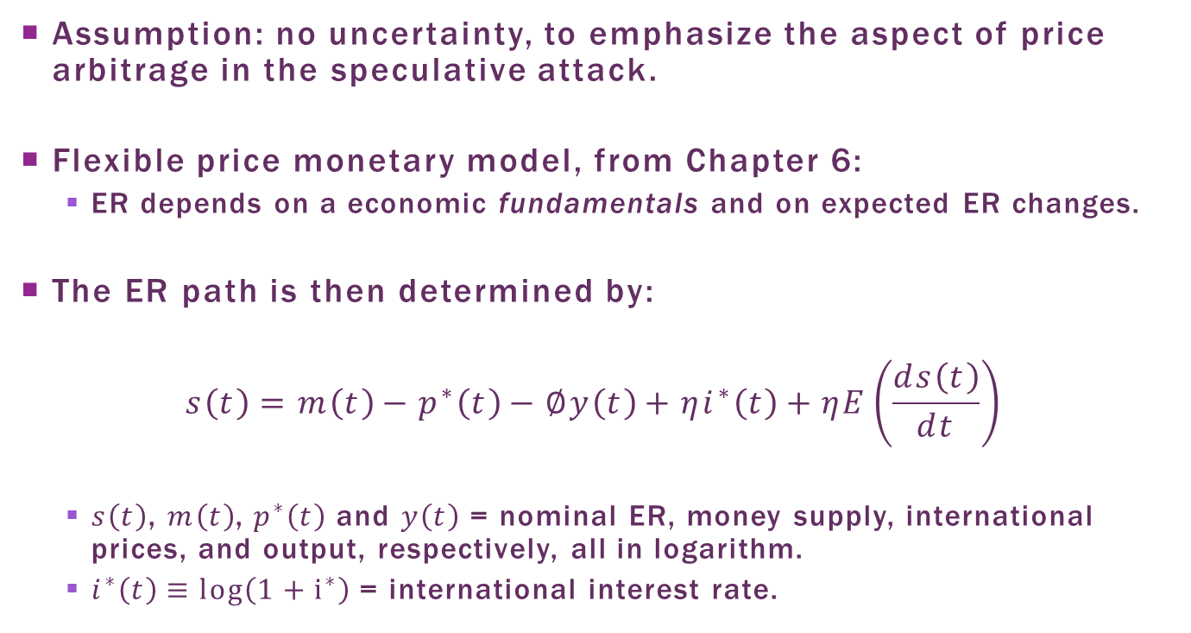
Model Setup
Assumption: no uncertainty, to emphasize the aspect of price arbitrage in the speculative attack.
Flexible price monetary model, from Chapter 6:
  ER depends on a economic fundamentals and on expected ER changes.
The ER path is then determined by:
$$s\left(t\right)=m\left(t\right)−p^{∗}\left(t\right)−∅y\left(t\right)+ηi^{∗}\left(t\right)+ηE\left(\frac{ds\left(t\right)}{dt}\right)$$
  $s\left(t\right)$, $m\left(t\right)$, $p^{∗}\left(t\right)$ and $y\left(t\right)$ = nominal ER, money supply, international prices, and output, respectively, all in logarithm.
  $i^{∗}\left(t\right)≡\log\left(1+i^{∗}\right)$ = international interest rate.

Slide 9
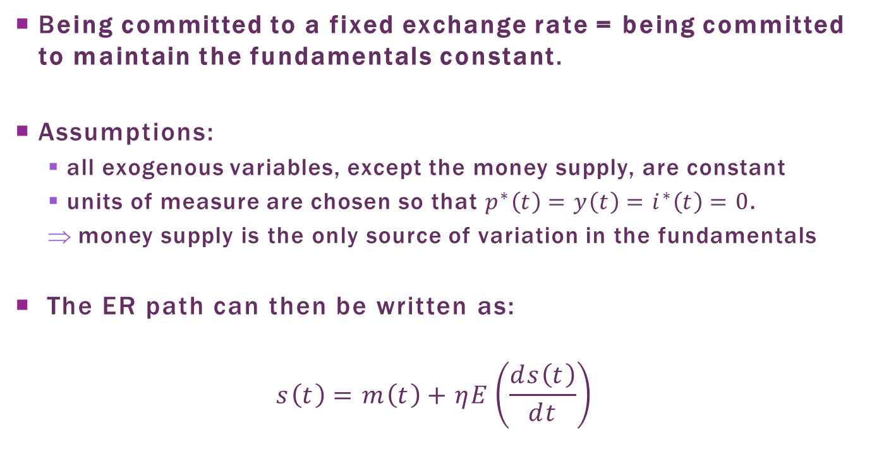
Exchange Rate Path
Being committed to a fixed exchange rate = being committed to maintain the fundamentals constant.
Assumptions:
  all exogenous variables, except the money supply, are constant
  units of measure are chosen so that $p^{∗}\left(t\right)=y\left(t\right)=i^{∗}\left(t\right)=0$.
  money supply is the only source of variation in the fundamentals
The ER path can then be written as:
$$s\left(t\right)=m\left(t\right)+ηE\left(\frac{ds\left(t\right)}{dt}\right)$$

Slide 10
Money supply
Central bank balance sheet:
  Money suppley = liability
  Domestic assets and international reserves = assets.
The central bank balance can be represented by:
  A = domestic assets
  R = international reserves measured in foreign currency.
Assets | Liabilities
A(t) | M(t)
S(t)R(t)

Slide 11
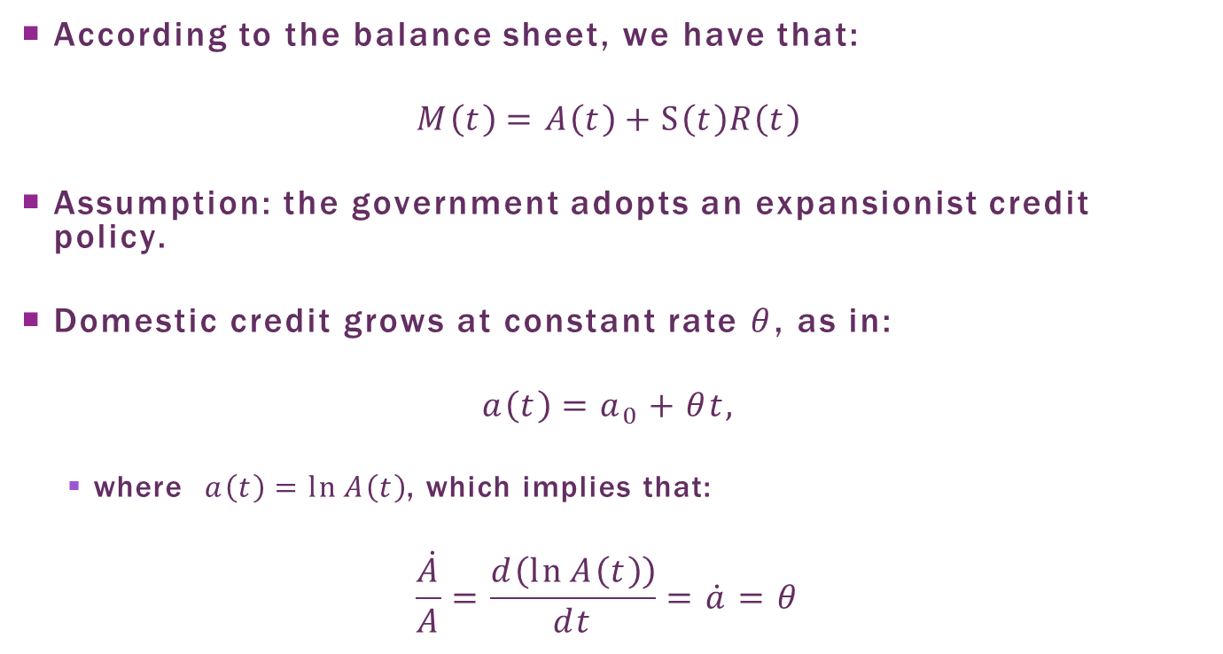
Credit Policy
According to the balance sheet, we have that:
$$M\left(t\right)=A\left(t\right)+S\left(t\right)R\left(t\right)$$
Assumption: the government adopts an expansionist credit policy.
Domestic credit grows at constant rate $θ$, as in:
$$a\left(t\right)=a_{0}+θt,$$
  where $a\left(t\right)=\ln{A\left(t\right)}$, which implies that:
$$\frac{\dot{A}}{A}=\frac{d\left(\ln{A\left(t\right)}\right)}{dt}=\dot{a}=θ$$

Slide 12
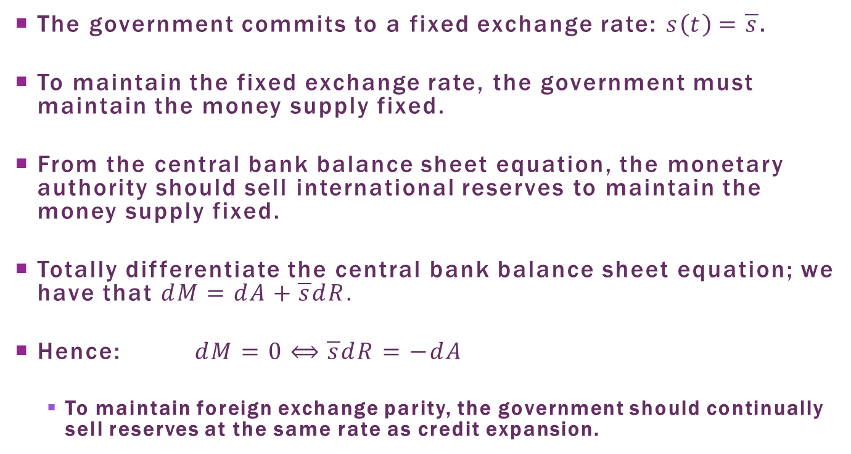
Monetary Policy
The government commits to a fixed exchange rate: $s\left(t\right)=\overline{s}$.
To maintain the fixed exchange rate, the government must maintain the money supply fixed.
From the central bank balance sheet equation, the monetary authority should sell international reserves to maintain the money supply fixed.
Totally differentiate the central bank balance sheet equation; we have that $dM=dA+\overline{s}dR.$
Hence: $dM=0⟺\overline{s}dR=−dA$
  To maintain foreign exchange parity, the government should continually sell reserves at the same rate as credit expansion.

Slide 13
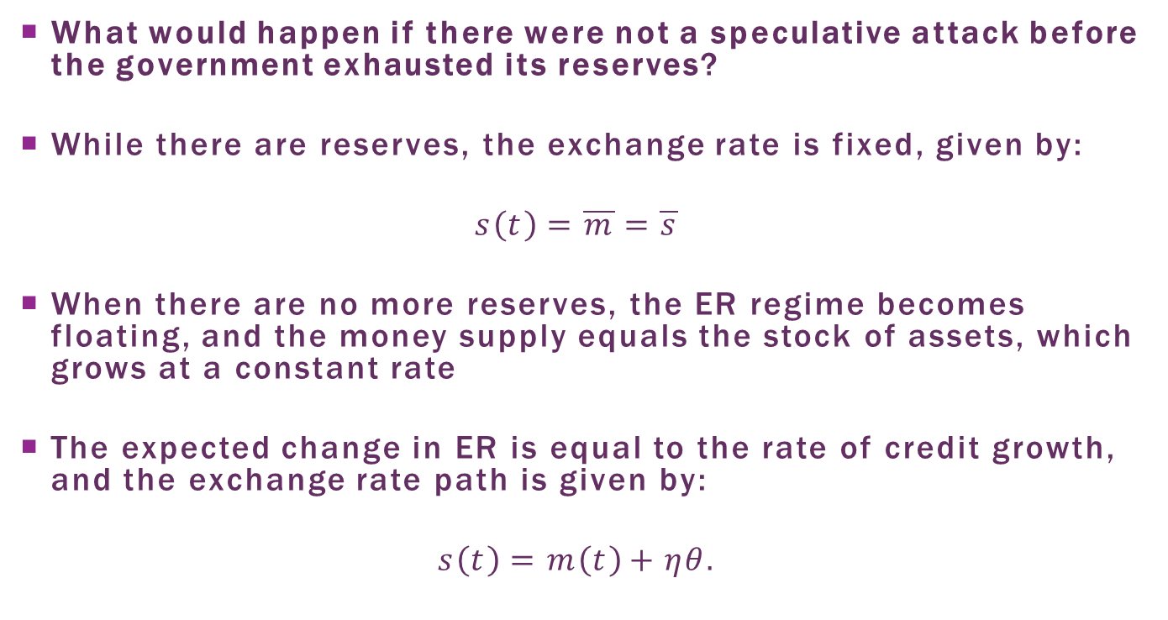
Exchange rate Paths
What would happen if there were not a speculative attack before the government exhausted its reserves?
While there are reserves, the exchange rate is fixed, given by:
$$s\left(t\right)=\overline{m}=\overline{s}$$
When there are no more reserves, the ER regime becomes floating, and the money supply equals the stock of assets, which grows at a constant rate
The expected change in ER is equal to the rate of credit growth, and the exchange rate path is given by:
$$s\left(t\right)=m\left(t\right)+ηθ.$$

Slide 14
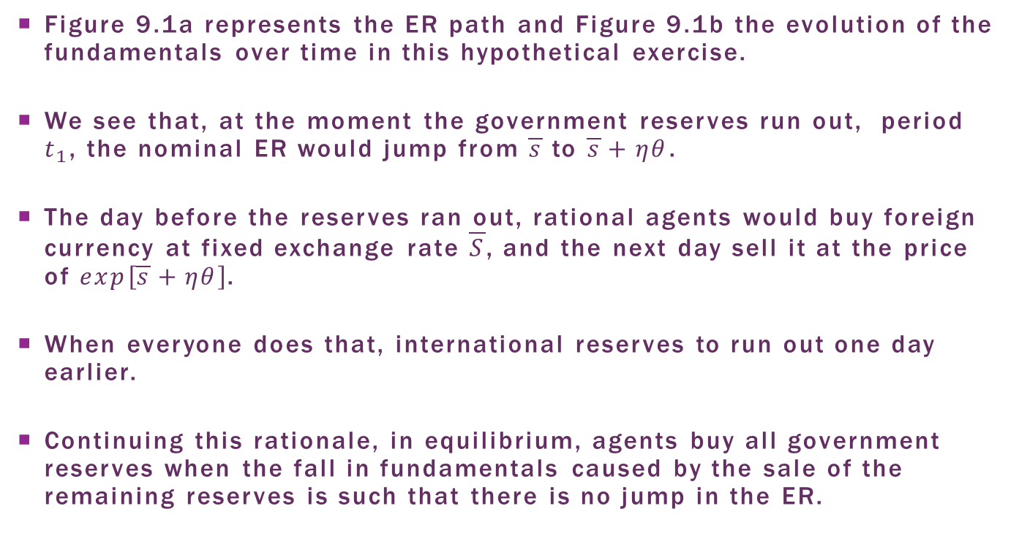
Speculative Attack
Figure 9.1a represents the ER path and Figure 9.1b the evolution of the fundamentals over time in this hypothetical exercise.
We see that, at the moment the government reserves run out, period $t_{1}$, the nominal ER would jump from $\overline{s}$ to $\overline{s}+ηθ$.
The day before the reserves ran out, rational agents would buy foreign currency at fixed exchange rate $\overline{S}$, and the next day sell it at the price of $exp\left[\overline{s}+ηθ\right]$.
When everyone does that, international reserves to run out one day earlier.
Continuing this rationale, in equilibrium, agents buy all government reserves when the fall in fundamentals caused by the sale of the remaining reserves is such that there is no jump in the ER.

Slide 15
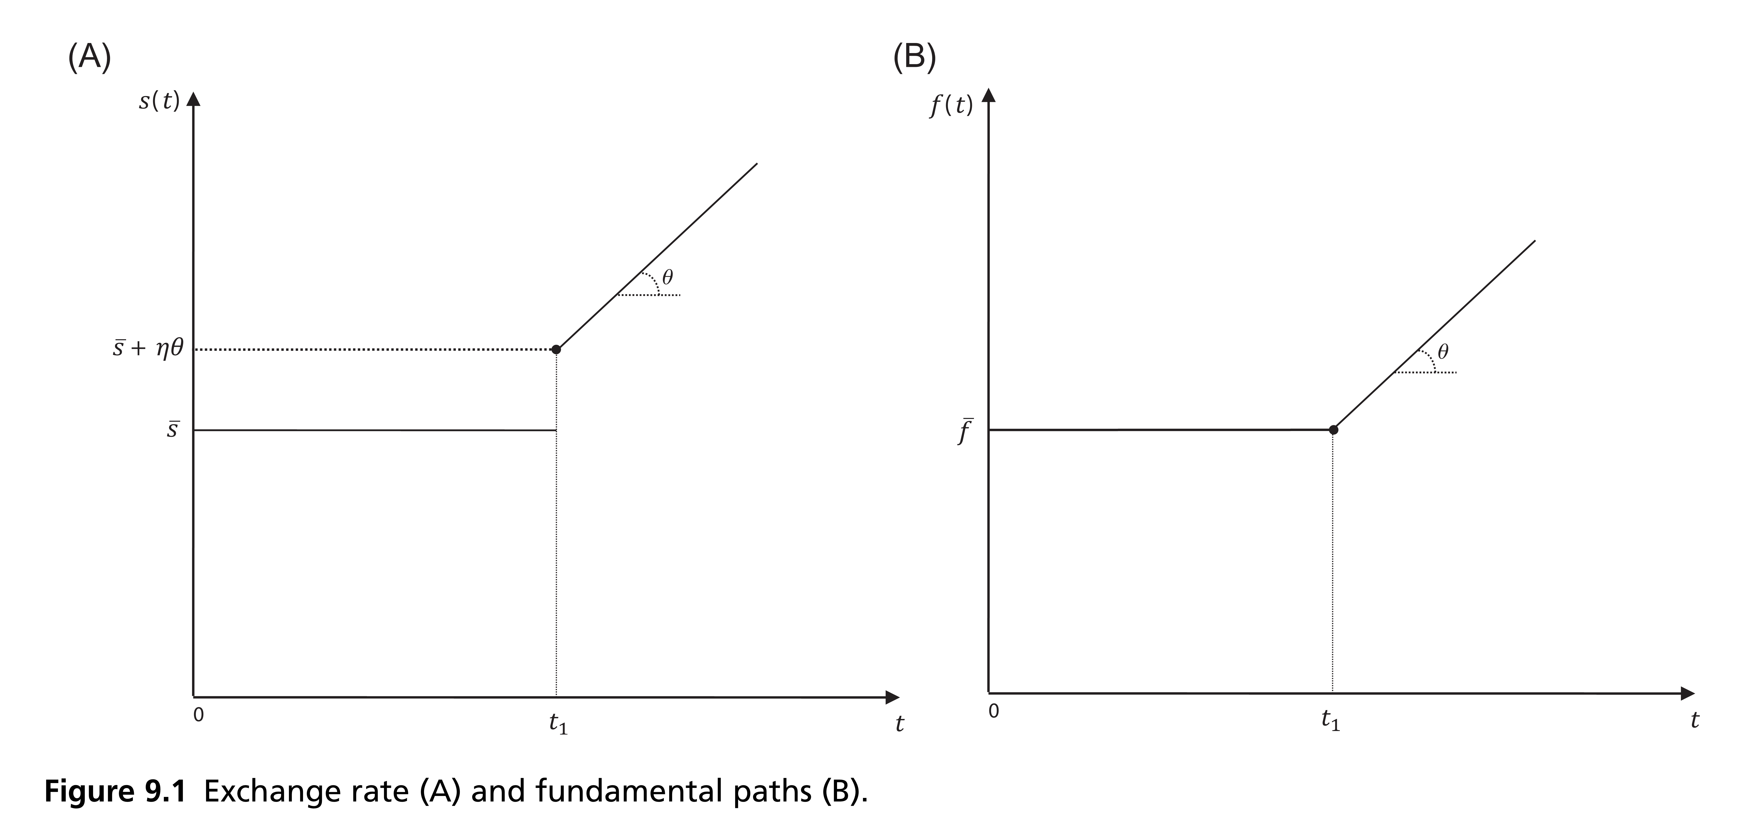
Exchange Rate and
Fundamentals Paths

Slide 16
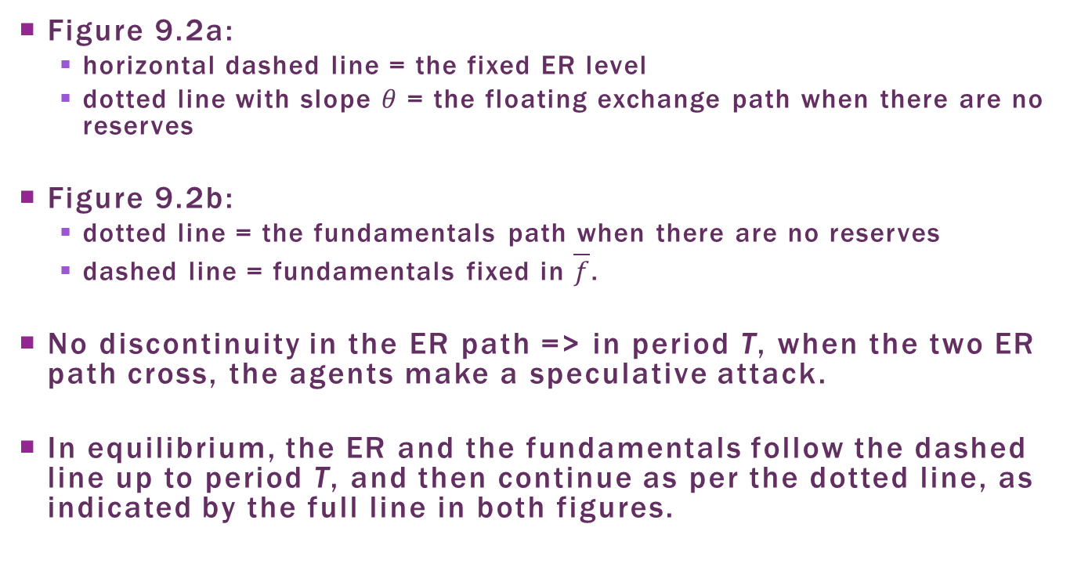
Equilibrium ER and
Fundamentals paths
Figure 9.2a:
  horizontal dashed line = the fixed ER level
  dotted line with slope $θ$ = the floating exchange path when there are no reserves
Figure 9.2b:
  dotted line = the fundamentals path when there are no reserves
  dashed line = fundamentals fixed in $\overline{f}$.
No discontinuity in the ER path => in period T, when the two ER path cross, the agents make a speculative attack.
In equilibrium, the ER and the fundamentals follow the dashed line up to period T, and then continue as per the dotted line, as indicated by the full line in both figures.

Slide 17
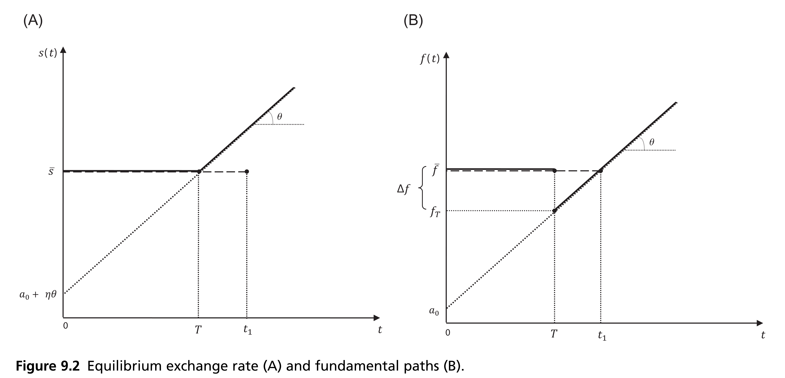
Equilibrium ER and
Fundamentals paths

Slide 18
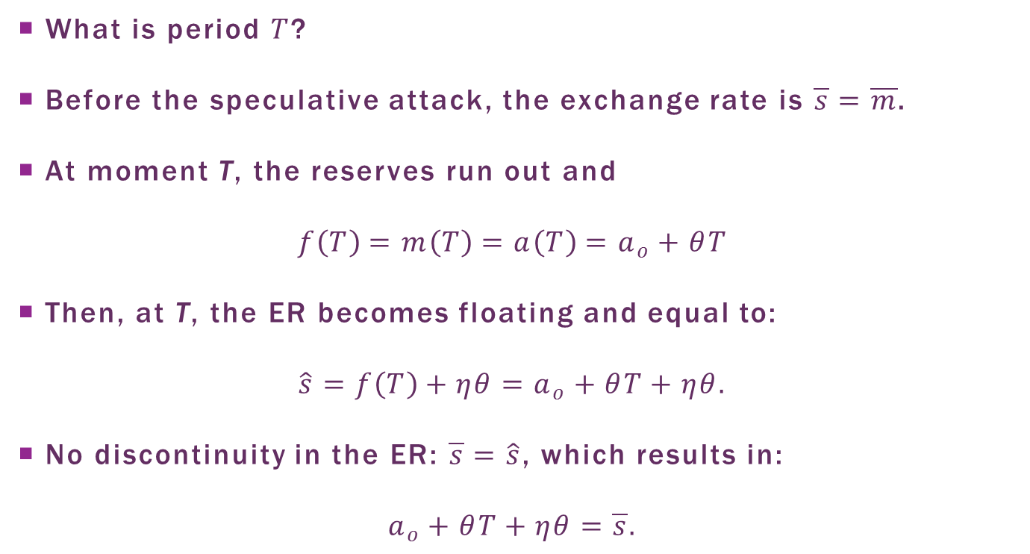
Time of the Speculative Attack
What is period $T$?
Before the speculative attack, the exchange rate is $\overline{s}=\overline{m}$.
At moment T, the reserves run out and
$$f\left(T\right)=m\left(T\right)=a\left(T\right)=a_{o}+θT$$
Then, at T, the ER becomes floating and equal to:
$$\hat{s}=f\left(T\right)+ηθ=a_{o}+θT+ηθ.$$
No discontinuity in the ER: $\overline{s}=\hat{s}$, which results in:
$$a_{o}+θT+ηθ=\overline{s}.$$

Slide 19
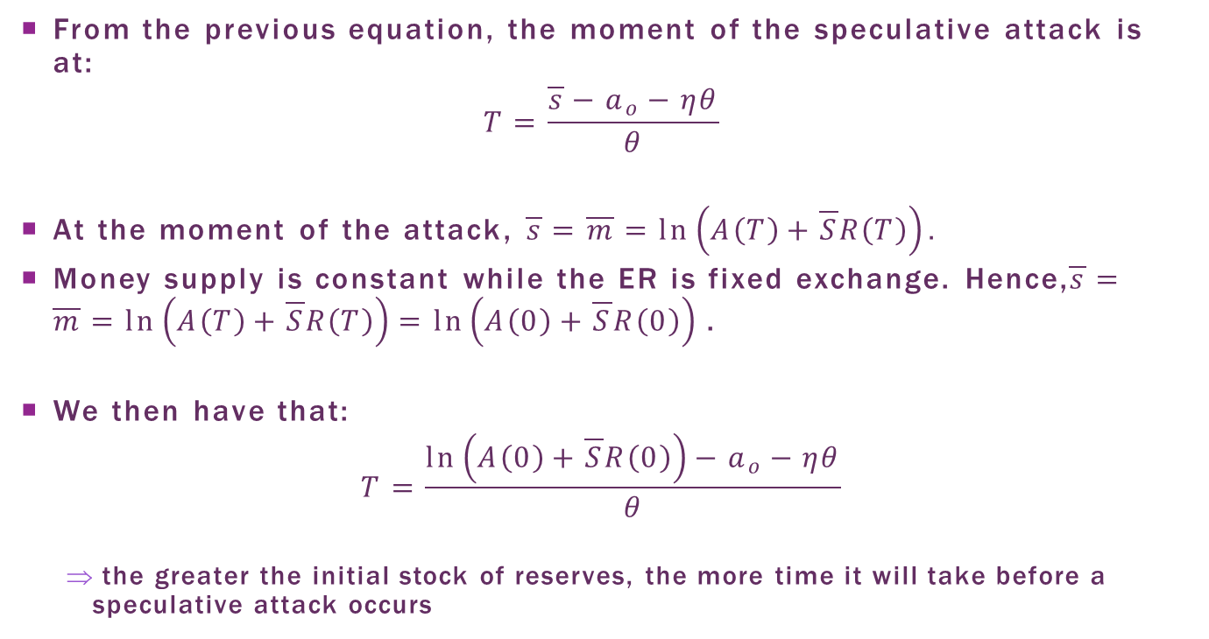
Time of the Speculative Attack
From the previous equation, the moment of the speculative attack is at:
$$T=\frac{\overline{s}−a_{o}−ηθ}{θ}$$
At the moment of the attack, $\overline{s}=\overline{m}=\ln\left(A\left(T\right)+\overline{S}R\left(T\right)\right).$
Money supply is constant while the ER is fixed exchange. Hence,$\overline{s}=\overline{m}=\ln\left(A\left(T\right)+\overline{S}R\left(T\right)\right)=\ln\left(A\left(0\right)+\overline{S}R\left(0\right)\right)$.
We then have that:
$$T=\frac{\ln\left(A\left(0\right)+\overline{S}R\left(0\right)\right)−a_{o}−ηθ}{θ}$$
  the greater the initial stock of reserves, the more time it will take before a speculative attack occurs

Slide 20
Summary
In sum:
  no uncertainty and with perfectly rational agents, a speculative attack occurs if the government credit policy is inconsistent with the fixed ER regime.
  Speculative attack = result of arbitrage of the price of foreign currency.
    If there were no attack, there would be an expected exchange rate jump.
    The agents arbitrate in the market so that, in equilibrium, the exchange rate follows a continuous path.

Slide 21
Model Limitations
Main criticism: the private agents are rational and act based on their own interests, while the government is an automaton, following policies inconsistent in the long run.
Defending the model: the government is not a monolithic block where economic policy decisions are made with the rationale of a single entity.
  Actually, the government is formed by a set of organs directed by different agents, each responsible for different political spheres.
  This can result in a set of conflicting policies.

Slide 22
Model limitations
Problem: prediction that the ER should not jump at the moment of crisis, which appears counterfactual.
  Adding uncertainty and private information, it is possible to generate discreet ER depreciation in a first generation model.
The model does not take into consideration other options to defend the currency
  For example, acquiring foreign loans to defend the ER parity, or imposing capital controls or restrictions on imports.
  Each of these results in different costs to the economy: is it worth the effort to continue defending the currency?
  This scenario enter the second-generation currency crisis models.

Slide 23
Plan
The Speculative Attack as Asset Price Arbitrage
Crises as Self-Fulfilling Prophecies
The Role of Banks and Foreign Debt
Contagion

Slide 24
Crises as Self-Fulfilling Prophecies
The European Monetary System crisis in the early 1990s brought new situations that are hard to be reconciled using the first generation models.
  The European countries that suffered speculative attacks did not follow clearly inconsistent economic policies
  They were developed countries whose governments had easy access to international credit, and also had other options to stabilize the exchange rate.
  The speculative attacks occurred without there being a significant worsening in the economic fundamentals.

Slide 25
Crises as Self-Fulfilling Prophecies
Currency crisis model proposed by Obstfeld (1986) was able to explain this type of situation, giving origin to the second-generation currency crisis models.
Two main elements.
  Abandoning of the fixed ER regime is not inevitable, but, rather, the result of a political decision. Defending the currency is costly, and the government to compare the costs and benefits of doing it.
  The speculative action by the agents affects the cost to maintain the ER parity, so that there can be self-fulfilling currency crises.

Slide 26
Simple 2nd Generation Model
Simple model based on Krugman (1996)
The government decides to either defend ER parity or allow the ER to float so as to minimize a loss function that tries to capture the trade-off between the cost to defend the exchange rate and the benefit of maintaining its parity.
Let us look at each of the elements of the government loss function.

Slide 27
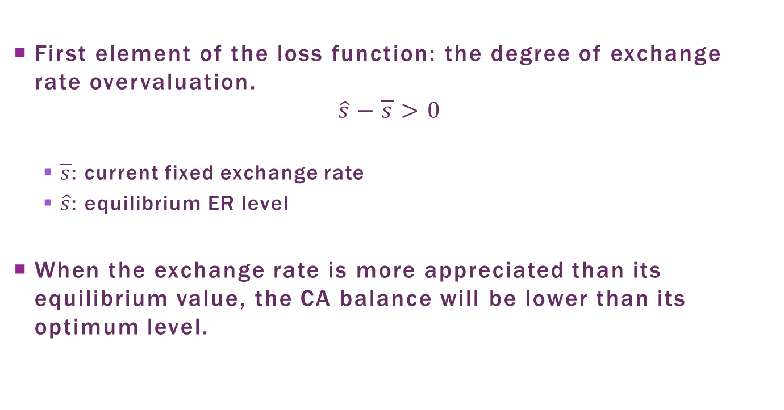
exchange rate misalignement
First element of the loss function: the degree of exchange rate overvaluation.
$$\hat{s}−\overline{s}>0$$
  $\overline{s}$: current fixed exchange rate
  $\hat{s}$: equilibrium ER level
When the exchange rate is more appreciated than its equilibrium value, the CA balance will be lower than its optimum level.

Slide 28
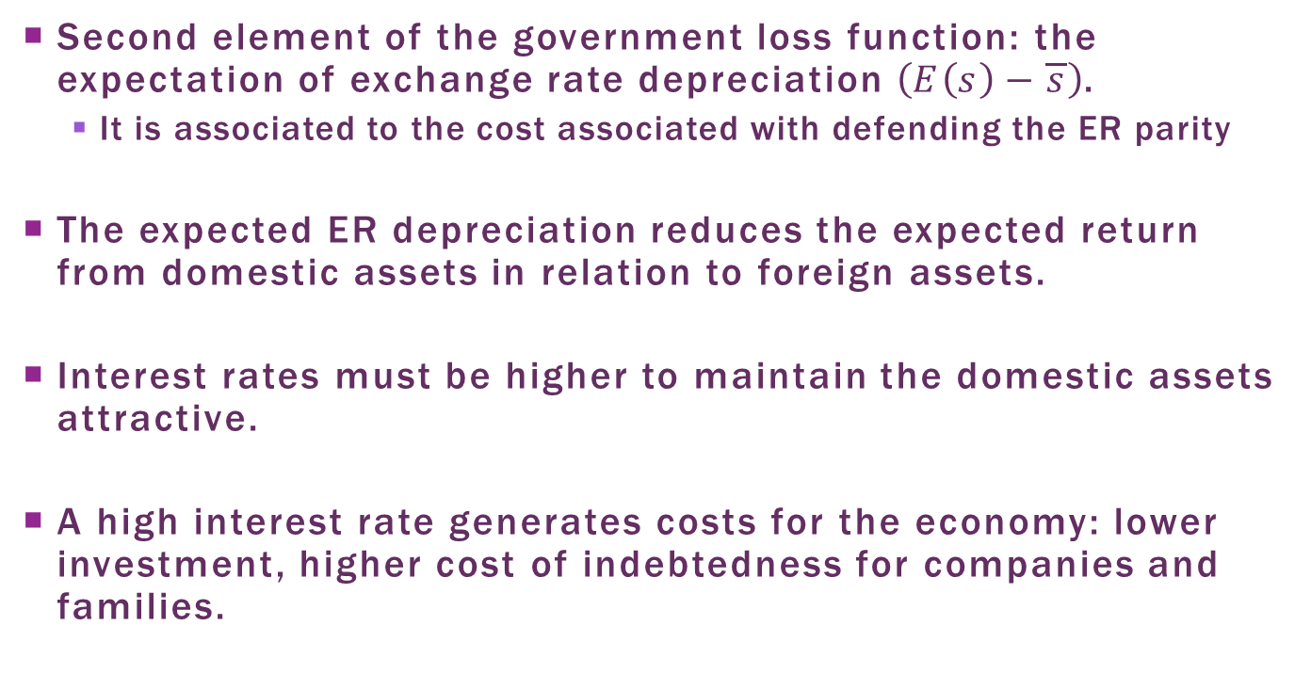
Expectated Depreciation
Second element of the government loss function: the expectation of exchange rate depreciation $\left(E\left(s\right)−\overline{s}\right)$.
  It is associated to the cost associated with defending the ER parity
The expected ER depreciation reduces the expected return from domestic assets in relation to foreign assets.
Interest rates must be higher to maintain the domestic assets attractive.
A high interest rate generates costs for the economy: lower investment, higher cost of indebtedness for companies and families.

Slide 29
Cost of Abandoning the ER Parity
Third element of the loss function: there a cost in abandoning ER parity.
Interpretations for this cost:
  Loss of government credibility for ceasing to follow the fixed exchange rate regime previously announced.
  A cost associated to the motive that led the government to adopt the fixed exchange rate regime, such as:
    Lower ER volatility to foster trade
    Nominal anchor in high inflation countries

Slide 30
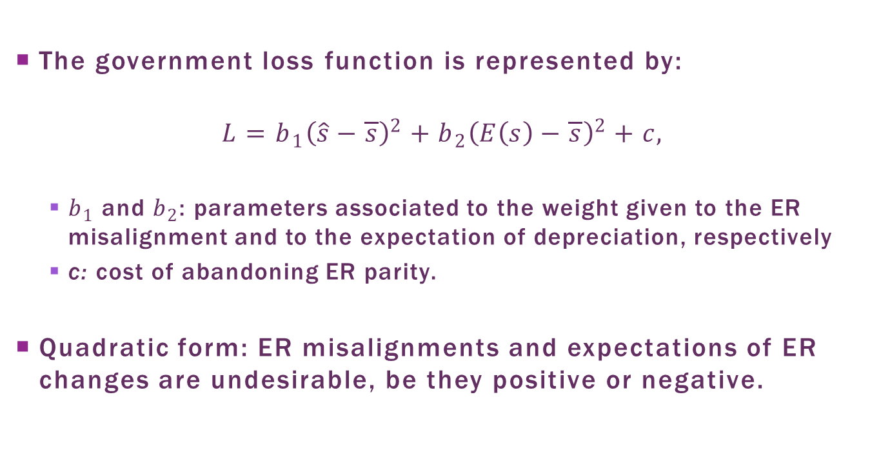
Loss Function
The government loss function is represented by:
$$L=b_{1}{\left(\hat{s}−\overline{s}\right)}^{2}+b_{2}{\left(E\left(s\right)−\overline{s}\right)}^{2}+c,$$
  $b_{1}$ and $b_{2}$: parameters associated to the weight given to the ER misalignment and to the expectation of depreciation, respectively
  c: cost of abandoning ER parity.
Quadratic form: ER misalignments and expectations of ER changes are undesirable, be they positive or negative.

Slide 31
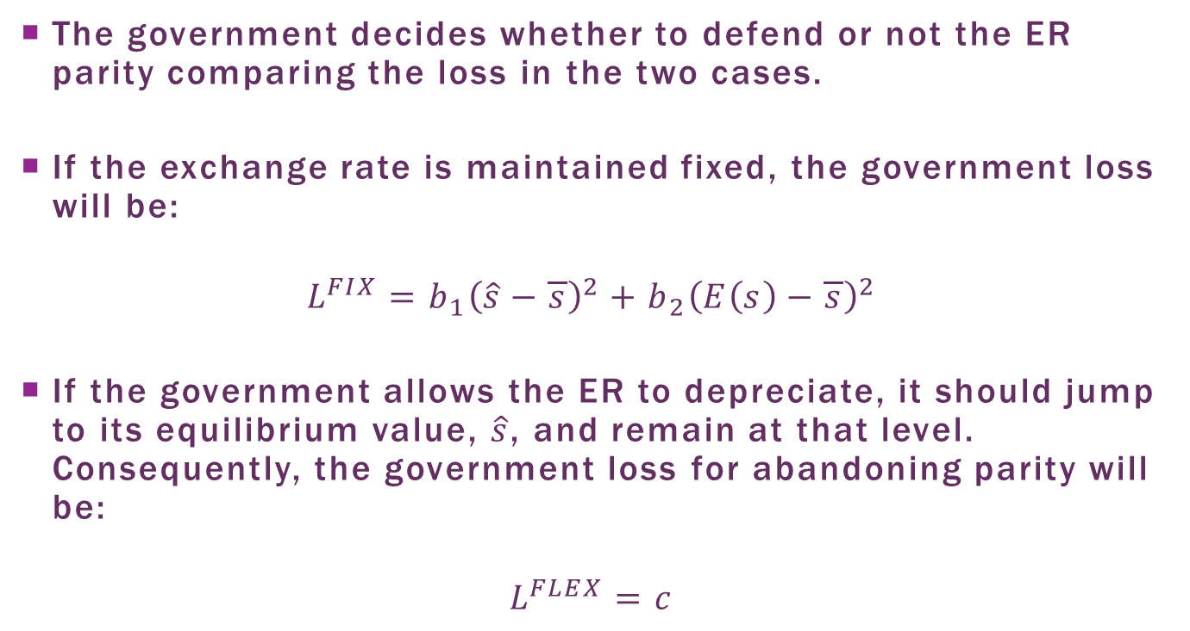
Abandon or not the Parity?
The government decides whether to defend or not the ER parity comparing the loss in the two cases.
If the exchange rate is maintained fixed, the government loss will be:
$$L^{FIX}=b_{1}{\left(\hat{s}−\overline{s}\right)}^{2}+b_{2}{\left(E\left(s\right)−\overline{s}\right)}^{2}$$
If the government allows the ER to depreciate, it should jump to its equilibrium value, $\hat{s}$, and remain at that level. Consequently, the government loss for abandoning parity will be:
$$L^{FLEX}=c$$

Slide 32
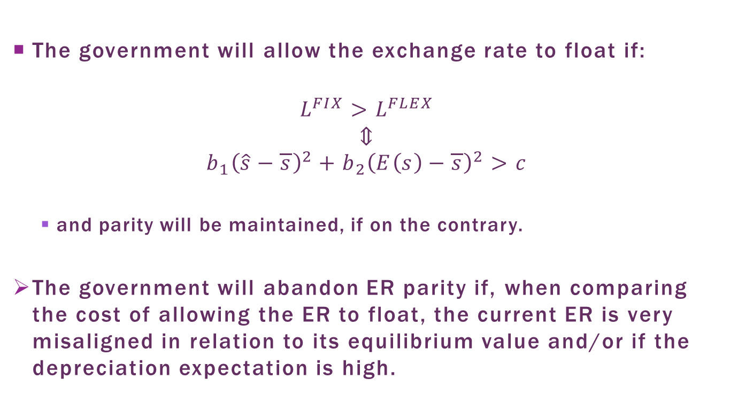
Abandon or not the Parity?
The government will allow the exchange rate to float if:
$$L^{FIX}>L^{FLEX}$$
$$⇕$$
$$b_{1}{\left(\hat{s}−\overline{s}\right)}^{2}+b_{2}{\left(E\left(s\right)−\overline{s}\right)}^{2}>c$$
  and parity will be maintained, if on the contrary.
The government will abandon ER parity if, when comparing the cost of allowing the ER to float, the current ER is very misaligned in relation to its equilibrium value and/or if the depreciation expectation is high.

Slide 33
Expectations and
Multiple Equilibria
Important role of expectations: they can sway the abandon of ER parity.
  Higher expectation of depreciation => more expensive for the government to maintain the parity => its abandon
  If the agents believe that the regime will be maintained, the cost to maintain it is lower and it can be maintained.
Multiple equilibria:
  equilibrium with bad expectations and a currency crisis, or
  equilibrium with good expectations and the maintenance of the fixed exchange rate regime.

Slide 34
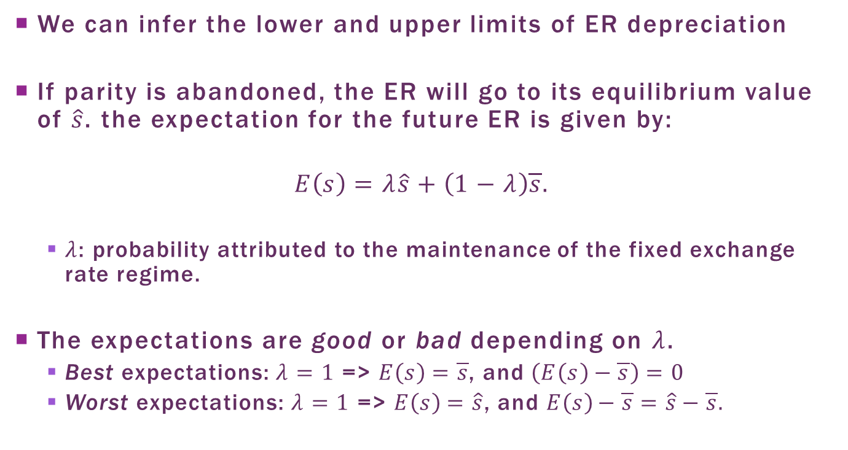
Expectations
We can infer the lower and upper limits of ER depreciation
If parity is abandoned, the ER will go to its equilibrium value of $\hat{s}$. the expectation for the future ER is given by:
$$E\left(s\right)=λ\hat{s}+\left(1−λ\right)\overline{s}.$$
  $λ$: probability attributed to the maintenance of the fixed exchange rate regime.
The expectations are good or bad depending on $λ$.
  Best expectations: $λ=1$ => $E\left(s\right)=\overline{s}$, and $\left(E\left(s\right)−\overline{s}\right)=0$
  Worst expectations: $λ=1$ => $E\left(s\right)=\hat{s}$, and $E\left(s\right)−\overline{s}=\hat{s}−\overline{s}.$

Slide 35
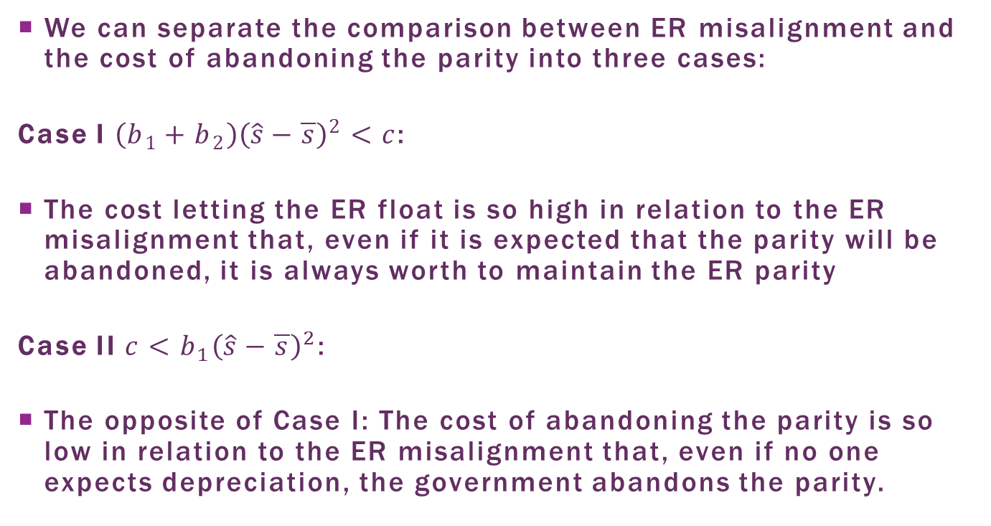
Three Cases
We can separate the comparison between ER misalignment and the cost of abandoning the parity into three cases:
Case I $\left(b_{1}+b_{2}\right){\left(\hat{s}−\overline{s}\right)}^{2}<c$:
The cost letting the ER float is so high in relation to the ER misalignment that, even if it is expected that the parity will be abandoned, it is always worth to maintain the ER parity
Case II ${c<b}_{1}{\left(\hat{s}−\overline{s}\right)}^{2}$:
The opposite of Case I: The cost of abandoning the parity is so low in relation to the ER misalignment that, even if no one expects depreciation, the government abandons the parity.

Slide 36
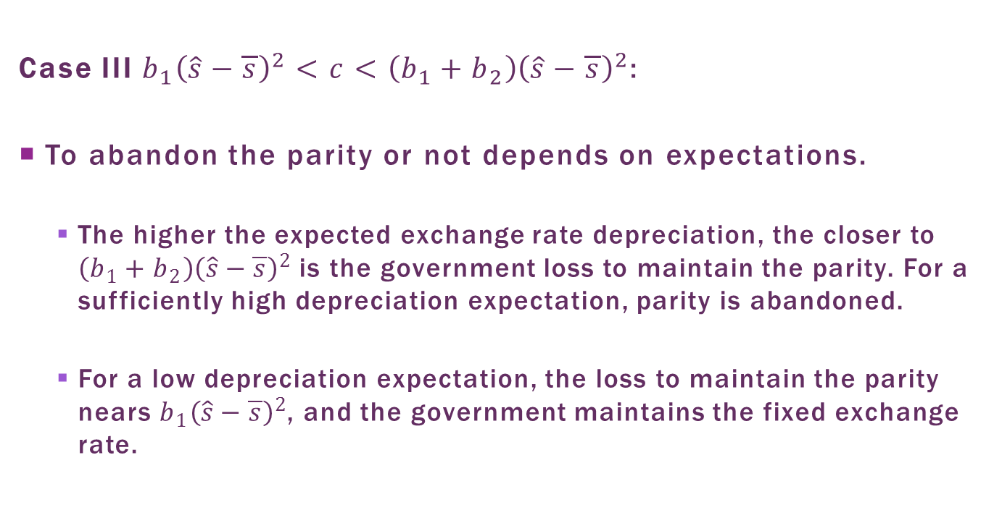
Three Cases
Case III $b_{1}{\left(\hat{s}−\overline{s}\right)}^{2}<c<\left(b_{1}+b_{2}\right){\left(\hat{s}−\overline{s}\right)}^{2}$:
To abandon the parity or not depends on expectations.
  The higher the expected exchange rate depreciation, the closer to $\left(b_{1}+b_{2}\right){\left(\hat{s}−\overline{s}\right)}^{2}$ is the government loss to maintain the parity. For a sufficiently high depreciation expectation, parity is abandoned.
  For a low depreciation expectation, the loss to maintain the parity nears $b_{1}{\left(\hat{s}−\overline{s}\right)}^{2}$, and the government maintains the fixed exchange rate.

Slide 37
Case study I:
Argentine Peso Misalignment
When the Argentine government instituted the currency board regime in 1990, the 1:1 parity of the peso against the dollar seemed to yield the equilibrium RER.
Currency crises in Russia and Brazil in 1999: investors more skeptical
Depreciation of over 60% of the Brazilian real against the dollar = depreciation of the real against the Argentine peso => deterioration of the Argentinian trade balance
The peso/dollar 1:1 parity, which was the equilibrium rate in 1990, in 1999 represented an overvalued RER

Slide 38
Case Study II:
European Monetary System Crisis
The deterioration of EMS member country fundamentals began with the 1990 German reunification.
  Significant increase in German government spending to integrate East Germany => increase in the fiscal deficit => debt/GDP went from about 39% in 1989 to about 56% in 1995.
  Higher aggregate demand due to higher fiscal deficit => higher activity level and interest rates (see Mundell-Fleming model)
  Higher economic activity => pressures prices up => contractionist monetary policy to avoid an inflationary spiral => even higher interest rate in Germany

Slide 39
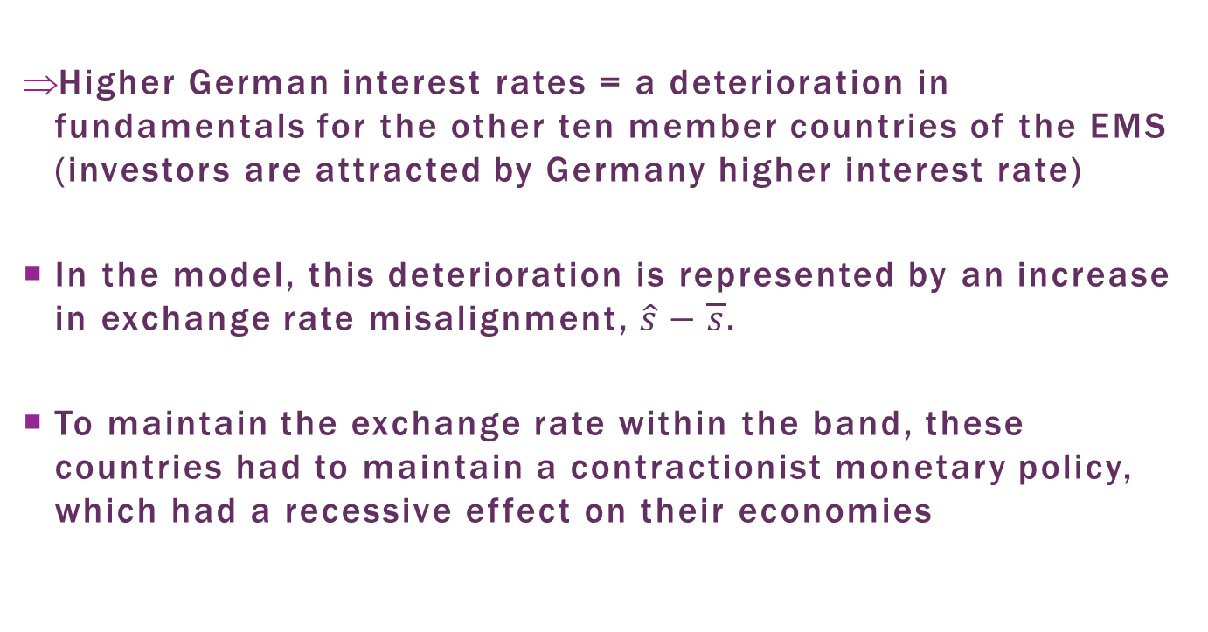
Case Study II:
European Monetary System Crisis
Higher German interest rates = a deterioration in fundamentals for the other ten member countries of the EMS (investors are attracted by Germany higher interest rate)
In the model, this deterioration is represented by an increase in exchange rate misalignment, $\hat{s}−\overline{s}$.
To maintain the exchange rate within the band, these countries had to maintain a contractionist monetary policy, which had a recessive effect on their economies

Slide 40
Case Study II:
European Monetary System Crisis
Interpretation: countries entered into a Case III scenario: they were ripe to have their currency attacked.
  If agents believe the government will abandon the parity, monetary contraction will need to be greater, making its cost excessive.
UK and Italy: high unemployment rates.
  September 1992: they abandoned the exchange rate bands after intense speculation on their currencies.
  It is reported that George Soros earned more than US$1 billion speculating against the sterling pound.

Slide 41
Self-fulfilling Currency Crisis Prophecies
Case III: there can be self-fulfilling currency crisis prophecies
  low expectation of abandoning parity => less costly to maintain the fixed ER => the ER remains effectively fixed.
  high depreciation expectation => costly to maintain the fixed ER => the government allows the ER to depreciate.
The exchange rate is ripe for being attacked.
What leads investors to reevaluate their expectations?
Mechanisms that coordinates negative expectations (ex.: currency crises in other countries with similar characteristics) can set off a speculative attack in a country ripe for attack.

Slide 42
First-Generation Models vs.
Second-Generation Models
The role of fundamental
  First-generation models: the crisis has its origin in the continued deterioration of the fundamentals.
  Second-generation models: emphasize the role of expectations. The fundamentals are not the best possible, but they are also not bad enough to the point of rendering the exchange rate parity clearly unsustainable.

Slide 43
First-Generation Models vs.
Second-Generation Models
Different implications as to the path of macroeconomic variables before and after the crisis.
  First-generation models: expansionist fiscal policy before and after the speculative attack, with a continuous deterioration of the fundamentals.
  Second-generation models: no specific standard for credit, monetary or fiscal policies before the speculative attack. Expansionist fiscal and monetary policies after the attack.

Slide 44
Plan
The Speculative Attack as Asset Price Arbitrage
Crises as Self-Fulfilling Prophecies
The Role of Banks and Foreign Debt
Contagion

Slide 45
The Role of Banks and Foreign Debt
Currency crises in Southeast Asia economies 1997-1998
  Not compatible with first-generation models: no fiscal deficits or policies inconsistent with exchange rate stability
  Not explained by second-generation models: high growth rates, hence no pressure for expansionist policies
New generation of currency crisis models.
Important element in the Asia crisis: financial fragility of these economies and ER instability.

Slide 46
Third Generation Models
Third-generation currency crisis models:
  the relation between the currency crisis and the fragility of the banking sector, and
  the indebtedness of banks and firms in foreign currency.
No standard third-generation model, as in the case of the previous generations
Two groups of models:
  Emphasis on the relation between banking and currency crises. Source of fragility: the illiquidity of the banking sector
  Focus on the indebtedness of firms and banks in foreign currency: mismatch of the monetary denomination of assets and liabilities.

Slide 47
Banking Crises and Currency Crises
The relation between bank and currency crises was already present in previous crises.
Twin crises: exchange rate and bank crises occurring simultaneously
Three possibilities:
  A currency crisis may lead to banking crisis
  A bank crisis can lead to a currency crisis
  A common factor leads to both a bank and a currency crisis at the same time.
Let us take a look at these mechanisms.

Slide 48
From Currency Crises to Banking Crises
We begin with how a currency crisis can lead to a banking crisis.
Fixed exchange rate regime:
  External shock (eg. increase in international interest rates)
  currency crisis
  to maintain exchange rate parity, the government sells reserves
  monetary contraction.
  The resulting reduction in credit can lead to a banking crisis.

Slide 49
From Currency Crises to Banking Crises
The very expectation of abandoning the parity can lead to a banking crisis.
High probability of depreciation => agents trade their local currency for foreign.
  At the rate they withdraw their money from the bank to buy foreign currency, banking sector fragility increases.
  the currency crisis can lead to a banking crisis.

Slide 50
From Banking Crises to Currency Crises
Banking crises, in turn, can also lead to currency crises.
Banks are, by their very nature, illiquid.
  They receive short-term deposits in cash and use them to concede mid and long-term loans.
They are subject to runs.
  If a large number of depositors believe there will be a run, they will withdraw their deposits and the bank can go bankrupt.
To avoid bank runs, the central bank offers some guarantees to depositors in all institutions.

Slide 51
From Banking Crises to Currency Crises
Exchange rate and banking crises can be even more intricate when the banks have short-term debt in foreign currency.
  A bank run can lead international creditors to not roll over short-term debt, increasing the problem of bank liquidity.
  On the other hand, an external shock that reduces the capital inflow can make depositors apprehensive regarding the solidity of domestic banks, leading to a run.
Financial liberalization and capital inflow, above all short-term, can, therefore, render the economy more vulnerable.

Slide 52
Firm Indebtedness in
Foreign Currency
Another strand of third-generation currency crisis models emphasizes the role of private sector foreign debt.
Intuition:
  Firm in debt in a foreign currency: exchange rate depreciation increases the value of the debt when measured in domestic currency.
  With a smaller profit, companies invest less, reducing future production, which leads to an even greater exchange rate depreciation.
  Therefore, a vicious circle of depreciation and recession would begin.

Slide 53
Firm Indebtedness in
Foreign Currency
Aghion, Bacchetta and Banerjee (2000): what is the best monetary policy to be used in the face of a currency crisis, taking into account firms’ indebtedness in a foreign currency?
Two effects are considered.
  Contractionist monetary policy => higher interest rate => attracts foreign capital => exchange rate appreciation => lower cost of the foreign debt denominated in foreign currency => greater profit => more investment => higher output
  Higher interest rate has the side effect of tightening credit for firms, restricting the possibility of new investments.
A contractionist monetary policy may not be the best answer to a currency crisis.

Slide 54
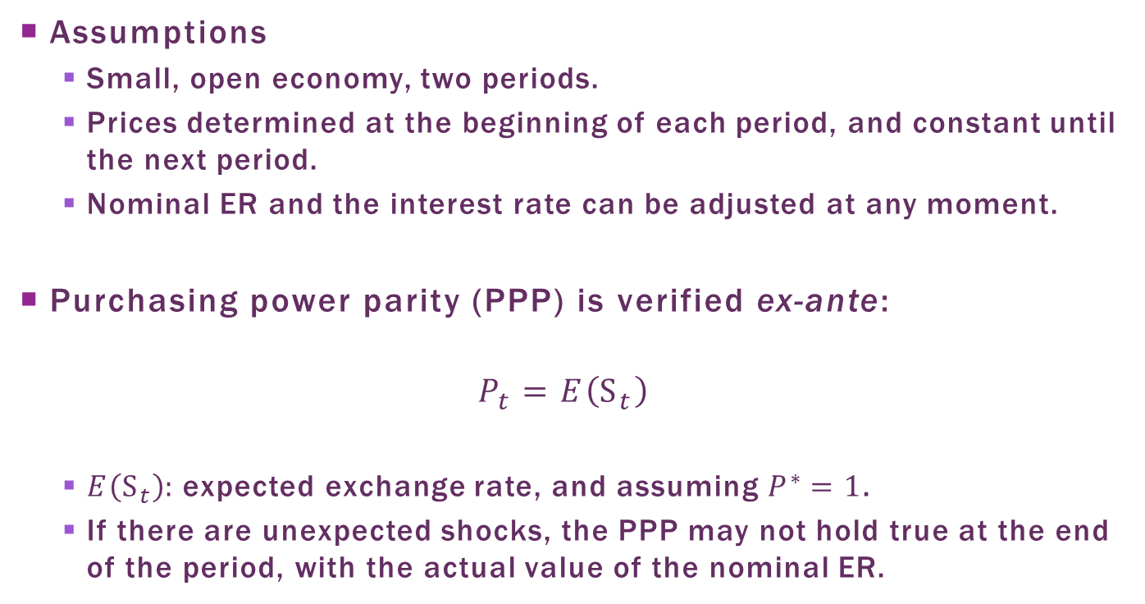
Model with Credit Constraint
Assumptions
  Small, open economy, two periods.
  Prices determined at the beginning of each period, and constant until the next period.
  Nominal ER and the interest rate can be adjusted at any moment.
Purchasing power parity (PPP) is verified ex-ante:
$$P_{t}=E\left(S_{t}\right)$$
  $E\left(S_{t}\right):$ expected exchange rate, and assuming $P^{∗}=1$.
  If there are unexpected shocks, the PPP may not hold true at the end of the period, with the actual value of the nominal ER.

Slide 55
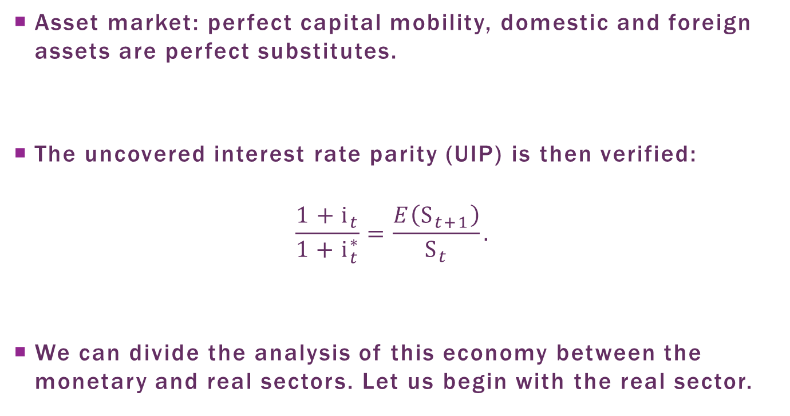
Asset Market
Asset market: perfect capital mobility, domestic and foreign assets are perfect substitutes.
The uncovered interest rate parity (UIP) is then verified:
$$\frac{1+i_{t}}{1+i_{t}^{∗}}=\frac{E\left(S_{t+1}\right)}{S_{t}}.$$
We can divide the analysis of this economy between the monetary and real sectors. Let us begin with the real sector.

Slide 56
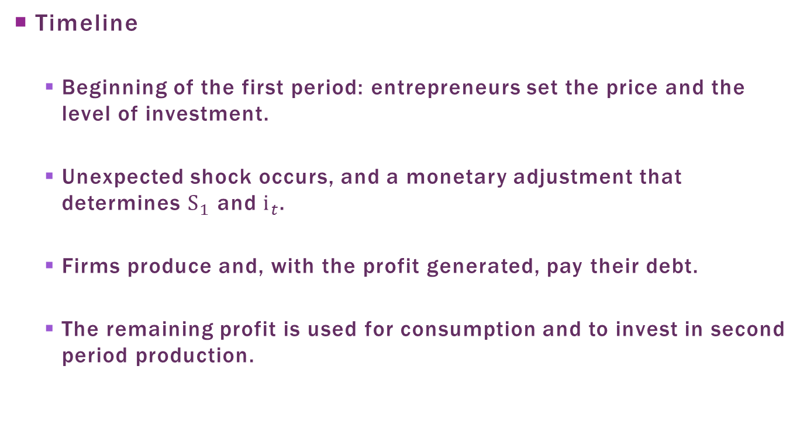
The Real Sector
Timeline
  Beginning of the first period: entrepreneurs set the price and the level of investment.
  Unexpected shock occurs, and a monetary adjustment that determines $S_{1}$ and $i_{t}$.
  Firms produce and, with the profit generated, pay their debt.
  The remaining profit is used for consumption and to invest in second period production.

Slide 57
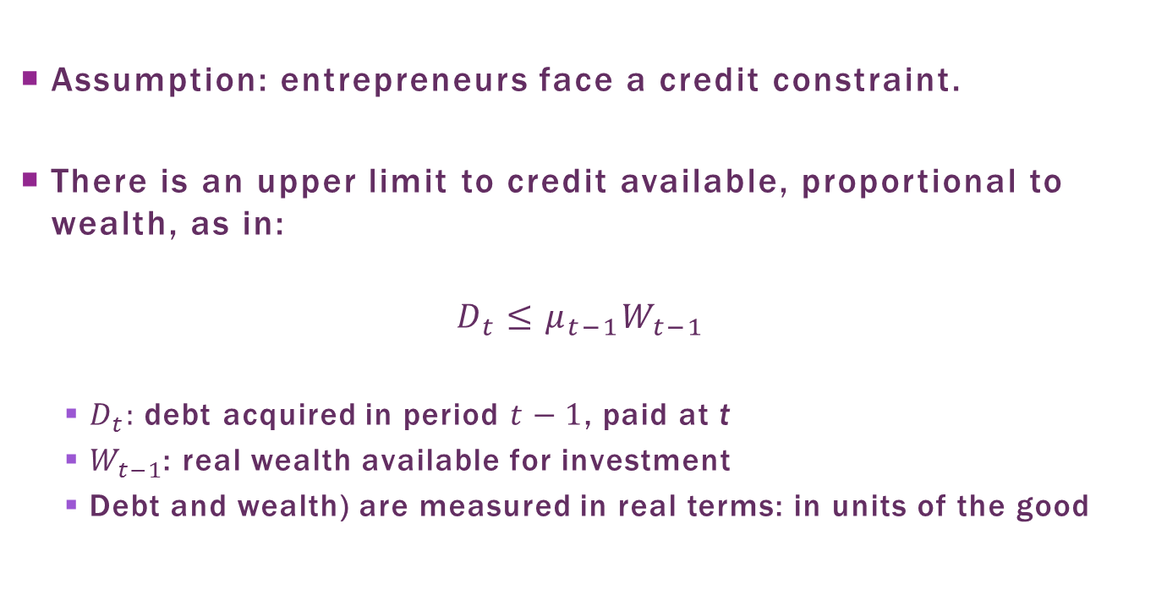
Credit Constraint
Assumption: entrepreneurs face a credit constraint.
There is an upper limit to credit available, proportional to wealth, as in:
$$D_{t}≤μ_{t−1}W_{t−1}$$
  $D_{t}:$ debt acquired in period $t−1$, paid at t
  $W_{t−1}$: real wealth available for investment
  Debt and wealth) are measured in real terms: in units of the good

Slide 58
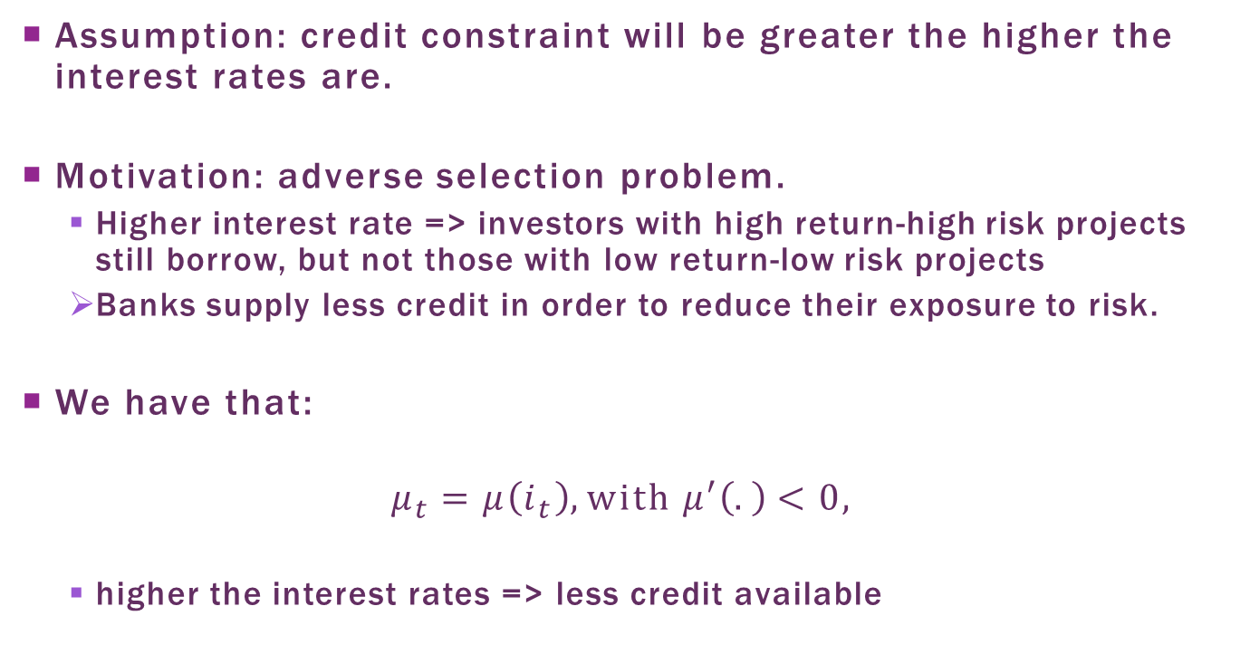
Credit Constraint and
Interest Rate
Assumption: credit constraint will be greater the higher the interest rates are.
Motivation: adverse selection problem.
  Higher interest rate => investors with high return-high risk projects still borrow, but not those with low return-low risk projects
  Banks supply less credit in order to reduce their exposure to risk.
We have that:
$$μ_{t}=μ\left(i_{t}\right), with μ′\left(.\right)<0,$$
  higher the interest rates => less credit available

Slide 59
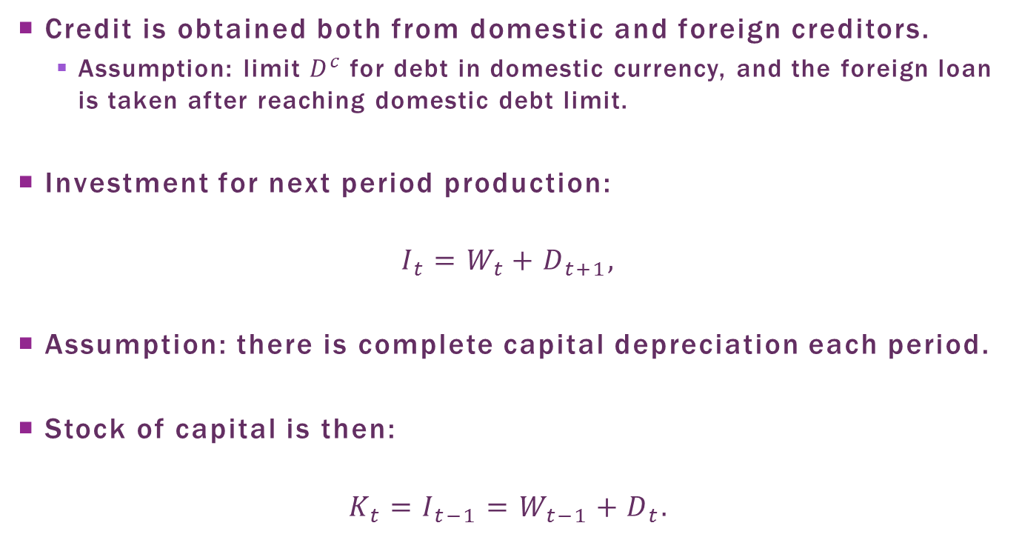
Investment and Capital
Credit is obtained both from domestic and foreign creditors.
  Assumption: limit $D^{c}$ for debt in domestic currency, and the foreign loan is taken after reaching domestic debt limit.
Investment for next period production:
$$I_{t}=W_{t}+D_{t+1},$$
Assumption: there is complete capital depreciation each period.
Stock of capital is then:
$$K_{t}=I_{t−1}=W_{t−1}+D_{t}.$$

Slide 60
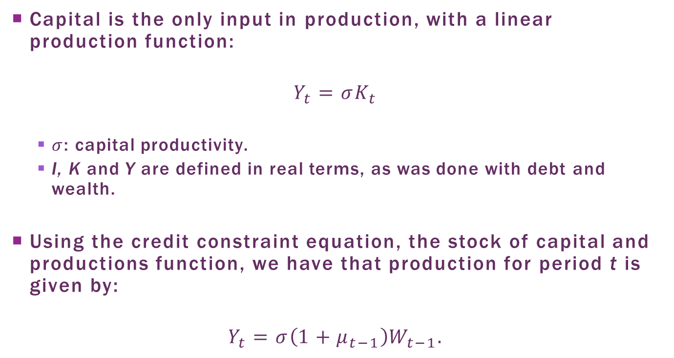
Production
Capital is the only input in production, with a linear production function:
$$Y_{t}={σK}_{t}$$
  $σ$: capital productivity.
  I, K and Y are defined in real terms, as was done with debt and wealth.
Using the credit constraint equation, the stock of capital and productions function, we have that production for period t is given by:
$$Y_{t}=σ\left(1+μ_{t−1}\right)W_{t−1}.$$

Slide 61
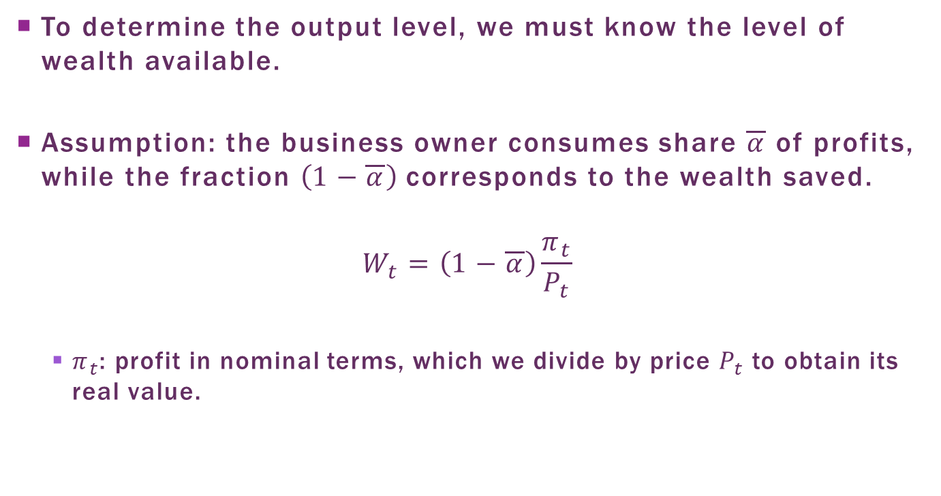
Wealth
To determine the output level, we must know the level of wealth available.
Assumption: the business owner consumes share $\overline{α}$ of profits, while the fraction$\left(1−\overline{α}\right)$ corresponds to the wealth saved.
$$W_{t}=\left(1−\overline{α}\right)\frac{π_{t}}{P_{t}}$$
  $π_{t}$: profit in nominal terms, which we divide by price $P_{t}$ to obtain its real value.

Slide 62
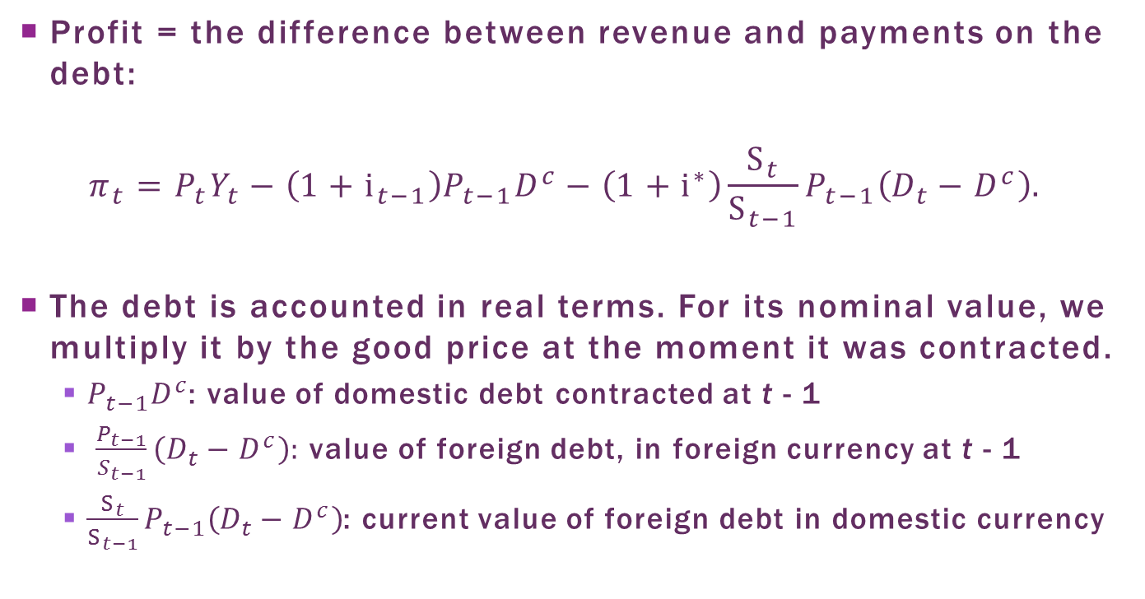
Profit
Profit = the difference between revenue and payments on the debt:
$$π_{t}=P_{t}Y_{t}−\left(1+i_{t−1}\right)P_{t−1}D^{c}−\left(1+i^{∗}\right)\frac{S_{t}}{S_{t−1}}P_{t−1}\left(D_{t}−D^{c}\right).$$
The debt is accounted in real terms. For its nominal value, we multiply it by the good price at the moment it was contracted.
  $P_{t−1}D^{c}$: value of domestic debt contracted at t - 1
  $\frac{P_{t−1}}{S_{t−1}}\left(D_{t}−D^{c}\right):$ value of foreign debt, in foreign currency at t - 1
  $\frac{S_{t}}{S_{t−1}}P_{t−1}\left(D_{t}−D^{c}\right)$: current value of foreign debt in domestic currency

Slide 63
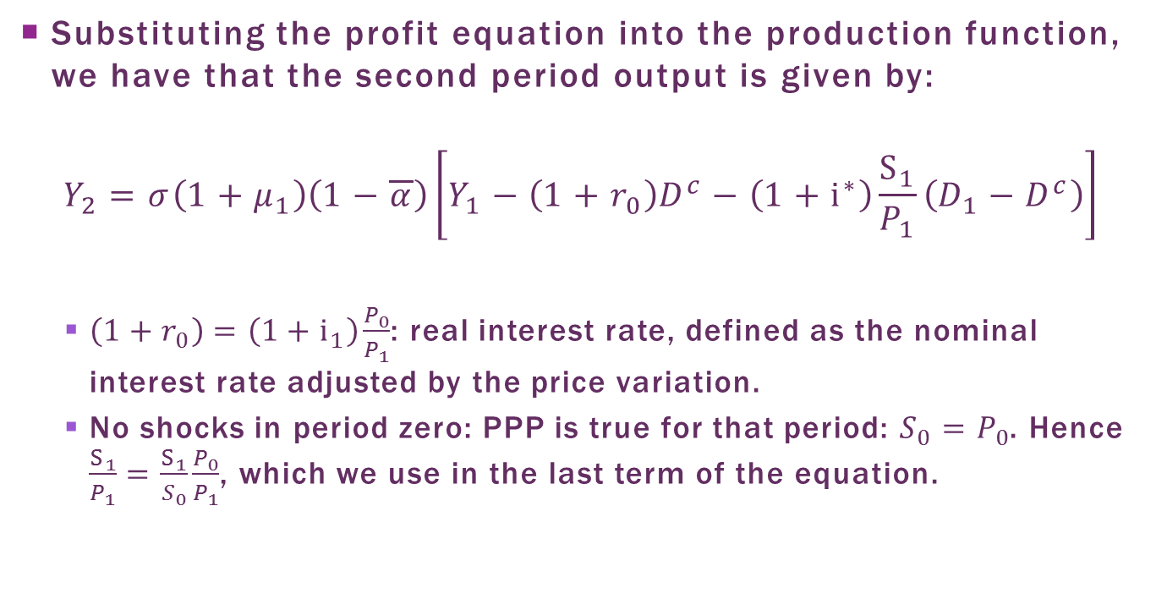
The Real Sector: Equilibrium
Substituting the profit equation into the production function, we have that the second period output is given by:
$$Y_{2}=σ\left(1+μ_{1}\right)\left(1−\overline{α}\right)\left[Y_{1}−\left(1+r_{0}\right)D^{c}−\left(1+i^{∗}\right)\frac{S_{1}}{P_{1}}\left(D_{1}−D^{c}\right)\right]$$
  $\left(1+r_{0}\right)=\left(1+i_{1}\right)\frac{P_{0}}{P_{1}}$: real interest rate, defined as the nominal interest rate adjusted by the price variation.
  No shocks in period zero: PPP is true for that period: $S_{0}=P_{0}$. Hence $\frac{S_{1}}{P_{1}}=\frac{S_{1}}{S_{0}}\frac{P_{0}}{P_{1}}$, which we use in the last term of the equation.

Slide 64
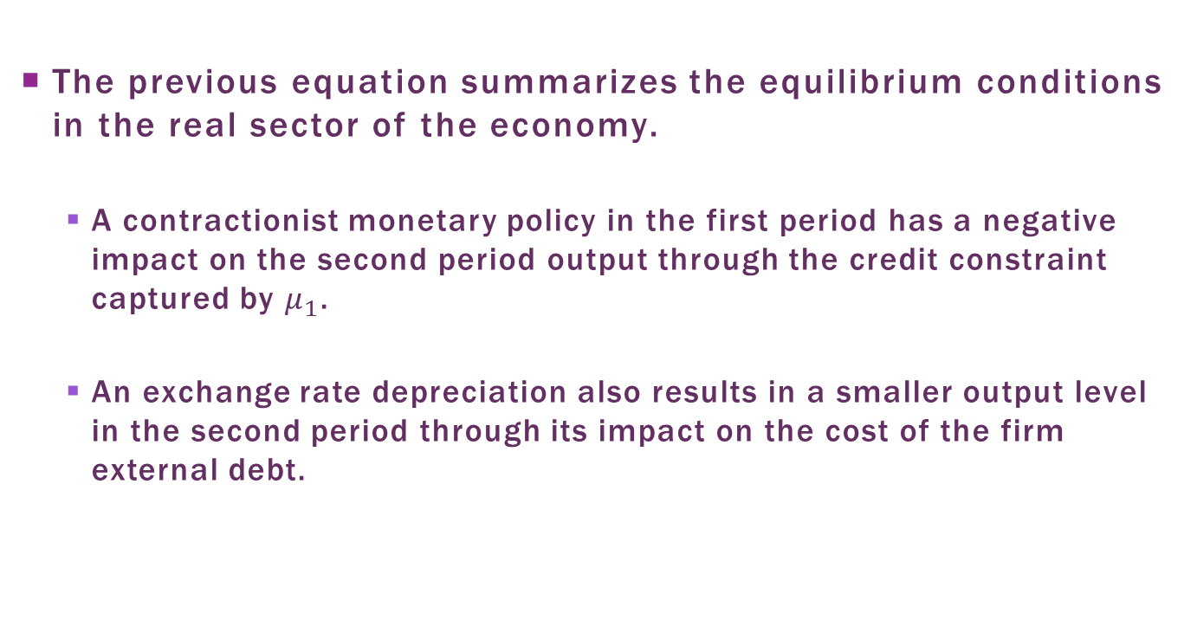
The Real Sector: Equilibrium
The previous equation summarizes the equilibrium conditions in the real sector of the economy.
  A contractionist monetary policy in the first period has a negative impact on the second period output through the credit constraint captured by $μ_{1}$.
  An exchange rate depreciation also results in a smaller output level in the second period through its impact on the cost of the firm external debt.

Slide 65
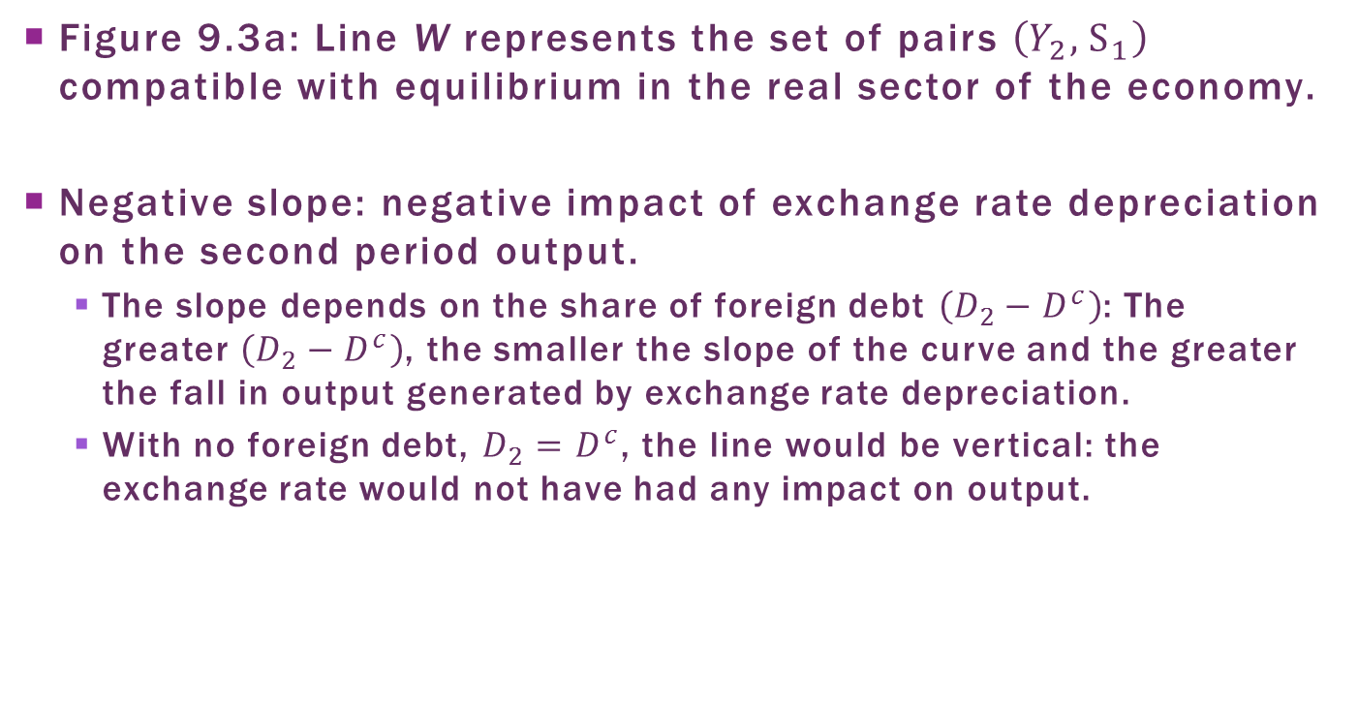
The Real Sector:
Graphic Representation
Figure 9.3a: Line W represents the set of pairs $\left(Y_{2},S_{1}\right)$ compatible with equilibrium in the real sector of the economy.
Negative slope: negative impact of exchange rate depreciation on the second period output.
  The slope depends on the share of foreign debt $\left(D_{2}−D^{c}\right)$: The greater $\left(D_{2}−D^{c}\right)$, the smaller the slope of the curve and the greater the fall in output generated by exchange rate depreciation.
  With no foreign debt, $D_{2}=D^{c}$, the line would be vertical: the exchange rate would not have had any impact on output.

Slide 66
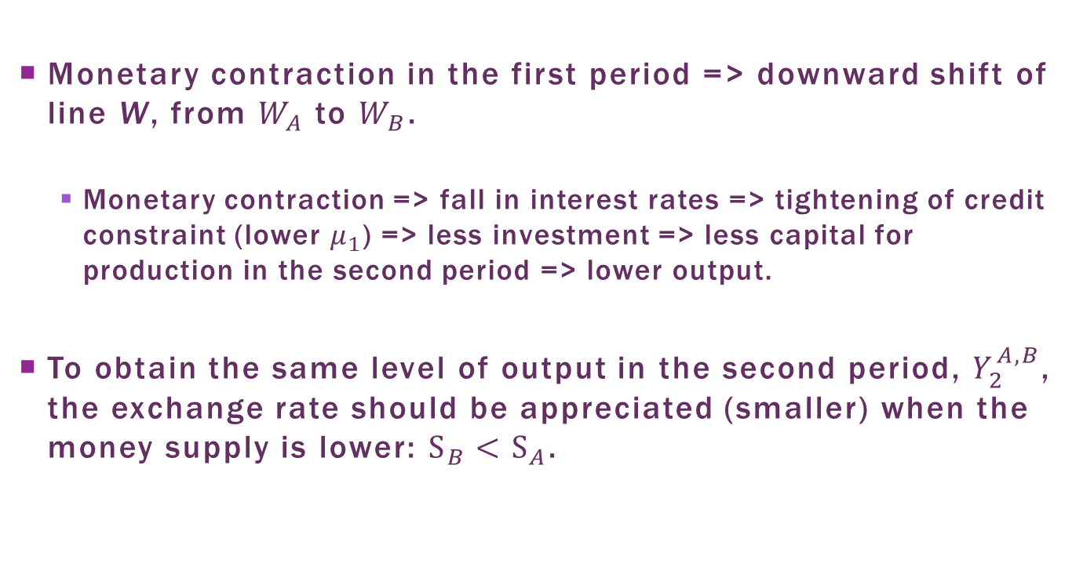
The Real Sector:
Graphic Representation
Monetary contraction in the first period => downward shift of line W, from $W_{A}$ to $W_{B}$.
  Monetary contraction => fall in interest rates => tightening of credit constraint (lower $μ_{1}$) => less investment => less capital for production in the second period => lower output.
To obtain the same level of output in the second period, $Y_{2}^{A,B}$, the exchange rate should be appreciated (smaller) when the money supply is lower: $S_{B}<S_{A}$.

Slide 67
Figure 9.3a: W Line

Slide 68
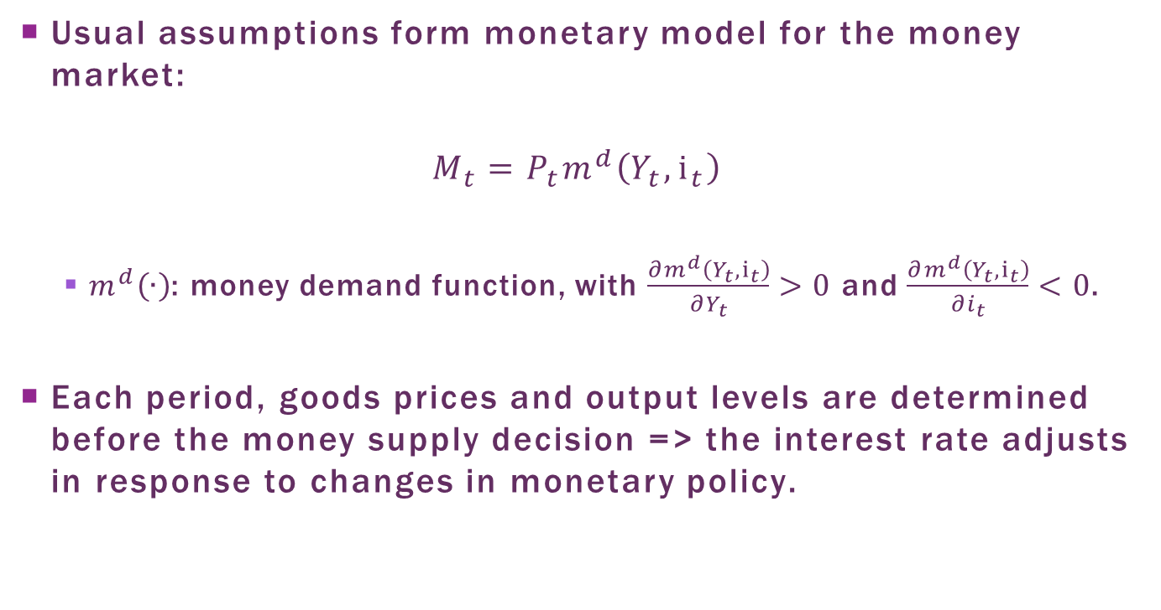
The Monetary Sector: Money Market
Usual assumptions form monetary model for the money market:
$$M_{t}=P_{t}m^{d}\left(Y_{t},i_{t}\right)$$
  $m^{d}\left(∙\right)$: money demand function, with $\frac{∂m^{d}\left(Y_{t},i_{t}\right)}{{∂Y}_{t}}>0$ and $\frac{∂m^{d}\left(Y_{t},i_{t}\right)}{{∂i}_{t}}<0$.
Each period, goods prices and output levels are determined before the money supply decision => the interest rate adjusts in response to changes in monetary policy.

Slide 69
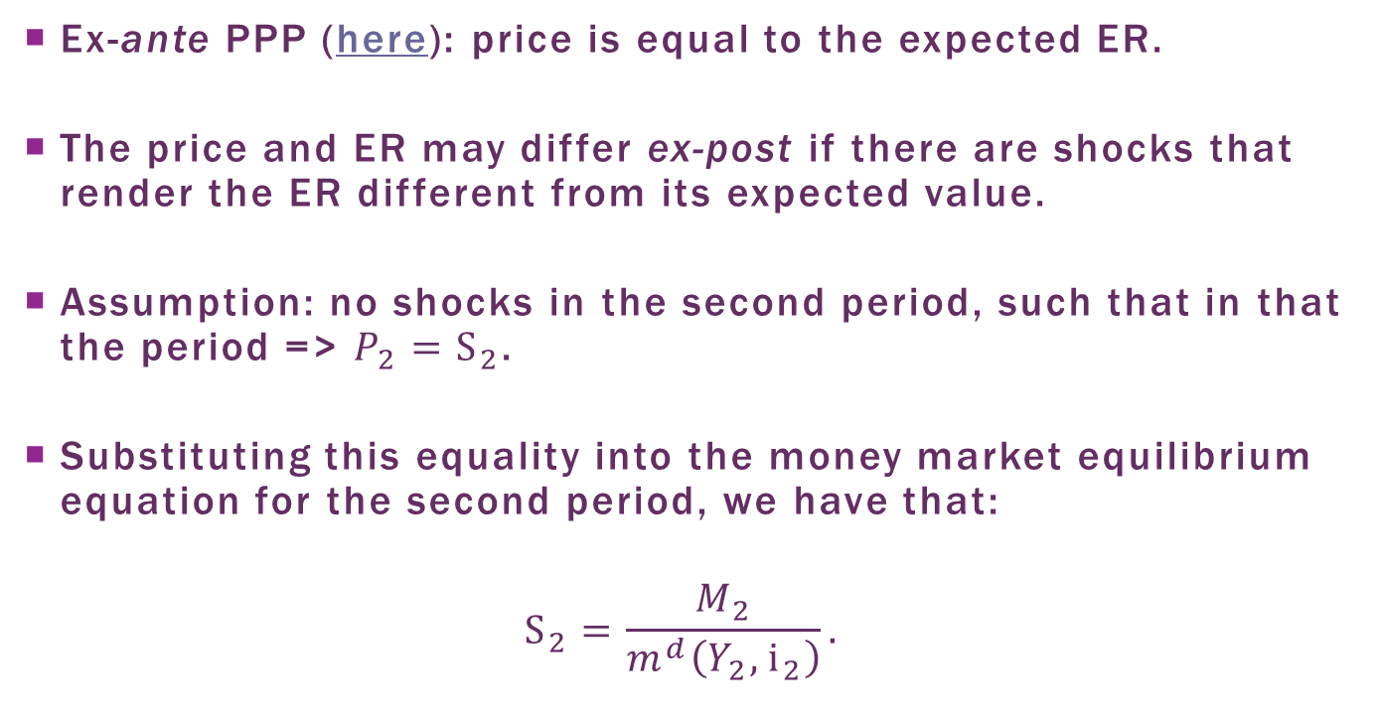
Exchange Rate in 2nd Period
Ex-ante PPP (here): price is equal to the expected ER.
The price and ER may differ ex-post if there are shocks that render the ER different from its expected value.
Assumption: no shocks in the second period, such that in that the period => $P_{2}=S_{2}$.
Substituting this equality into the money market equilibrium equation for the second period, we have that:
$$S_{2}=\frac{M_{2}}{m^{d}\left(Y_{2},i_{2}\right)}.$$

Slide 70
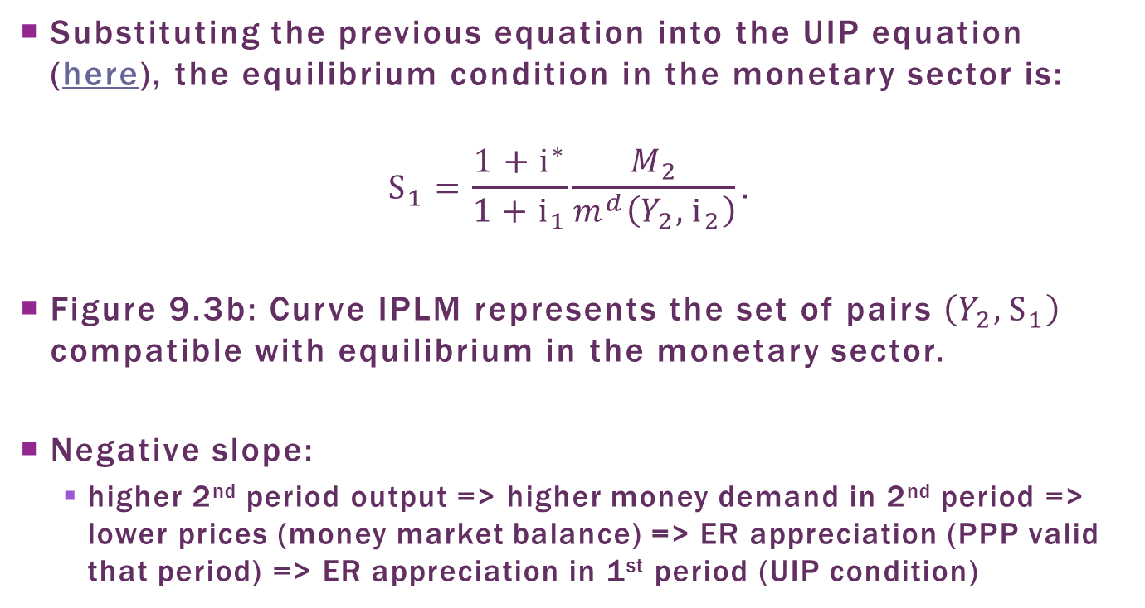
the Monetary Sector: Equilibrium
Substituting the previous equation into the UIP equation (here), the equilibrium condition in the monetary sector is:
$$S_{1}=\frac{{1+i}^{∗}}{{1+i}_{1}}\frac{M_{2}}{m^{d}\left(Y_{2},i_{2}\right)}.$$
Figure 9.3b: Curve IPLM represents the set of pairs $\left(Y_{2},S_{1}\right)$ compatible with equilibrium in the monetary sector.
Negative slope:
  higher 2nd period output => higher money demand in 2nd period => lower prices (money market balance) => ER appreciation (PPP valid that period) => ER appreciation in 1st period (UIP condition)

Slide 71
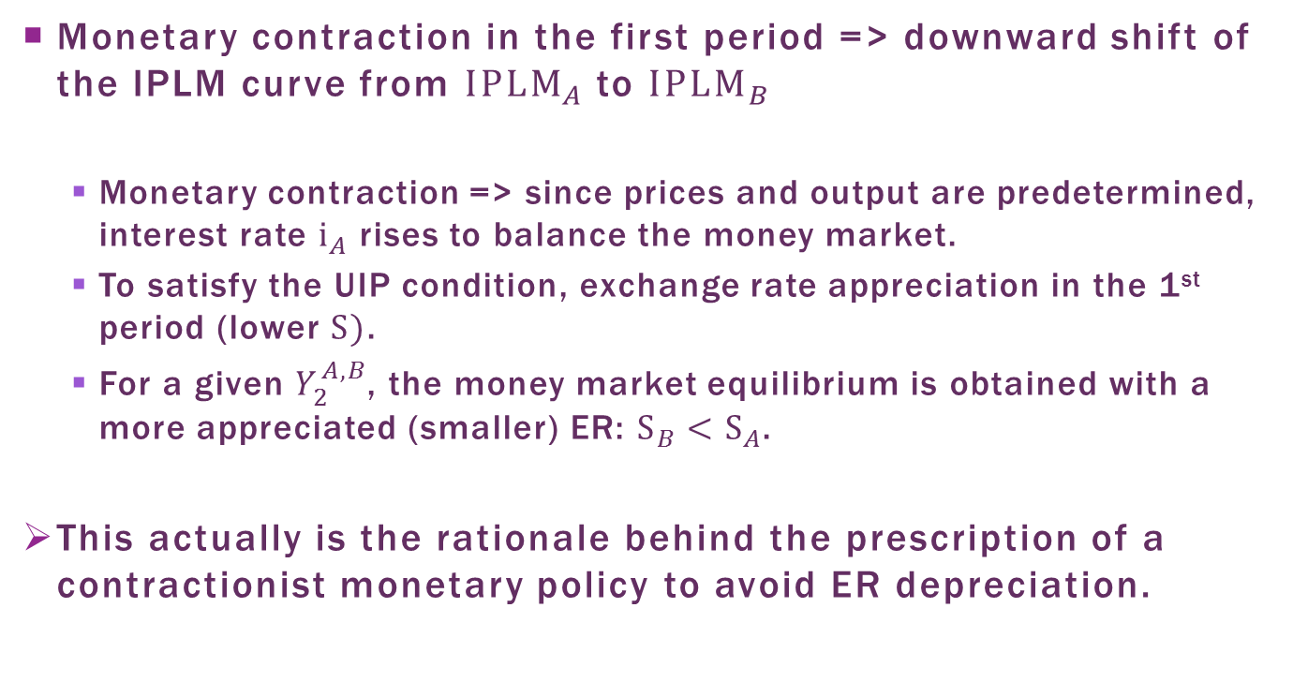
The Monetary Sector:
Graphic Representation
Monetary contraction in the first period => downward shift of the IPLM curve from ${IPLM}_{A}$ to ${IPLM}_{B}$
  Monetary contraction => since prices and output are predetermined, interest rate $i_{A}$ rises to balance the money market.
  To satisfy the UIP condition, exchange rate appreciation in the 1st period (lower$S)$.
  For a given $Y_{2}^{A,B}$, the money market equilibrium is obtained with a more appreciated (smaller) ER: $S_{B}<S_{A}$.
This actually is the rationale behind the prescription of a contractionist monetary policy to avoid ER depreciation.

Slide 72
Figure 9.3b: IPLM Curve

Slide 73
Equilibrium
The economy is in equilibrium when the monetary and real sectors are simultaneously in equilibrium.
In the graph: the point where curves IPLM and W intercept.
Three possible cases for the relative positioning of the two curves:
  Figure 9.4a: the good equilibrium. Only one interception point between the two curves, with positive output level and a low (appreciated) ER
  Figure 9.4b: there is only one equilibrium, albeit, not a good one: strong ER depreciation => firm go bankrupt while paying its debt in foreign currency.
  Figure 9.4c: there are multiple equilibria
    equilibrium A: equivalent to the first case
    equilibrium B: equivalent to the second case

Slide 74
Figure 9.4a: Unique Equilibrium

Slide 75
Figure 9.4b: Bad Equilibrium

Slide 76
Figure 9.4c: Multiple Equilibria

Slide 77
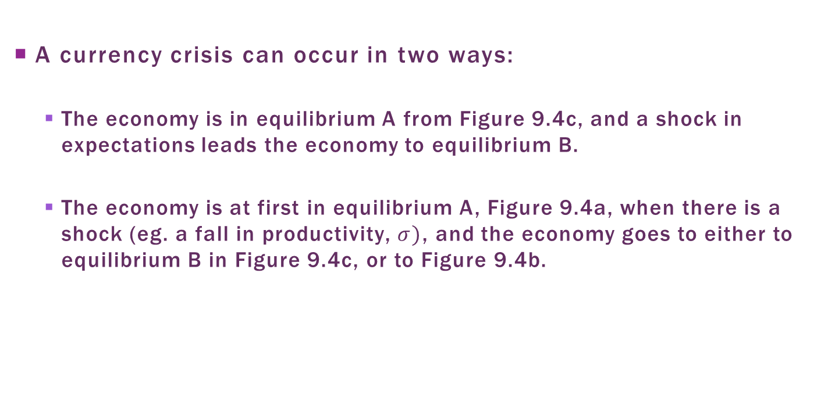
Equilibrium
A currency crisis can occur in two ways:
  The economy is in equilibrium A from Figure 9.4c, and a shock in expectations leads the economy to equilibrium B.
  The economy is at first in equilibrium A, Figure 9.4a, when there is a shock (eg. a fall in productivity, $σ)$, and the economy goes to either to equilibrium B in Figure 9.4c, or to Figure 9.4b.

Slide 78
Optimal policy in Face of
Currency Crisis
What should be the monetary policy in face of a currency crisis?
  Usual prescription: contractionist monetary policy, raising interest rate.
Monetary sector: monetary contraction => shift of the IPLM curve in Figure 9.3b => ER appreciation
However, real sector: monetary contraction would also shift down the W curve on Figure 9.3a => ER?
The net effect of monetary policy on ER and output depends on its relative impact on the real and monetary sectors.

Slide 79
Stronger response of
Real SEctor
If W curve shift > IPLM curve shift => the economy can move towards the Figure 9.4b case, the bad equilibrium
Intuition
  Real sector: monetary contraction => large tightening of credit => lower 2nd period output.
  Monetary sector: smaller 2nd period output => lower demand for money => higher prices in 2nd period to balance money market => ER depreciates in 2nd period (PPP) => ER depreciates in 1st period (UIP)

Slide 80
Stronger Response of
Monetary Sector
If IPLM curve shift > W curve shift => the economy moves towards the Figure 9.4a case, the good equilibrium
Intuition:
  Monetary sector: higher interest rates attracts foreign capital => exchange rate appreciation (UIP).
  Real sector: the impact of higher interest rate on the credit constraint, which would cause exchange rate depreciation, is relatively smaller.
  In this case, monetary contraction has the desired effect of avoiding a currency crisis.

Slide 81
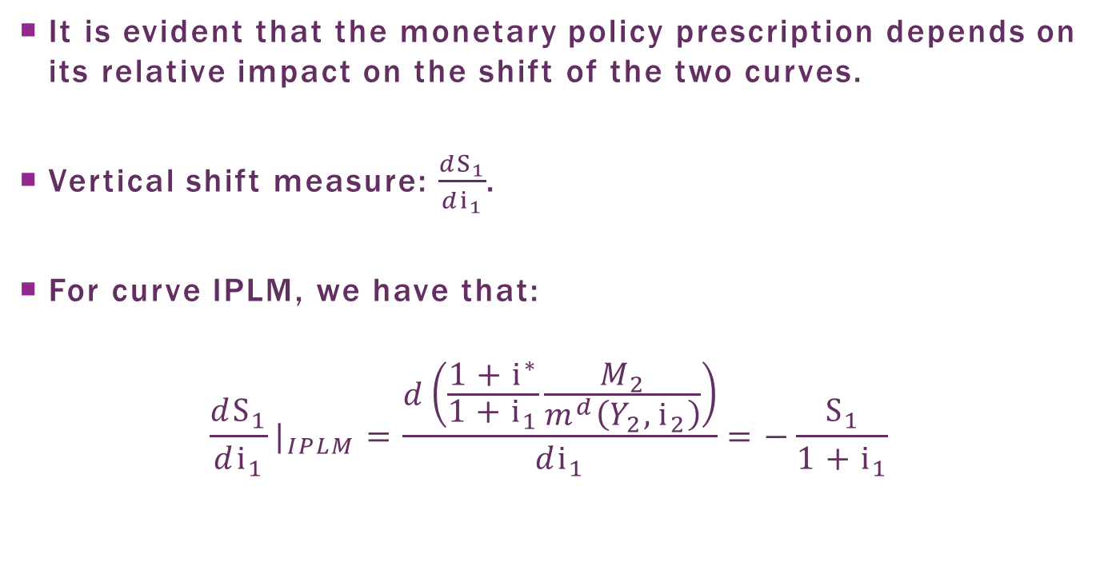
Optimal choice
It is evident that the monetary policy prescription depends on its relative impact on the shift of the two curves.
Vertical shift measure:$\frac{dS_{1}}{di_{1}}$.
For curve IPLM, we have that:
$$\frac{dS_{1}}{di_{1}}|_{IPLM}=\frac{d\left(\frac{1+i^{∗}}{{1+i}_{1}}\frac{M_{2}}{m^{d}\left(Y_{2},i_{2}\right)}\right)}{di_{1}}=−\frac{S_{1}}{{1+i}_{1}}$$

Slide 82
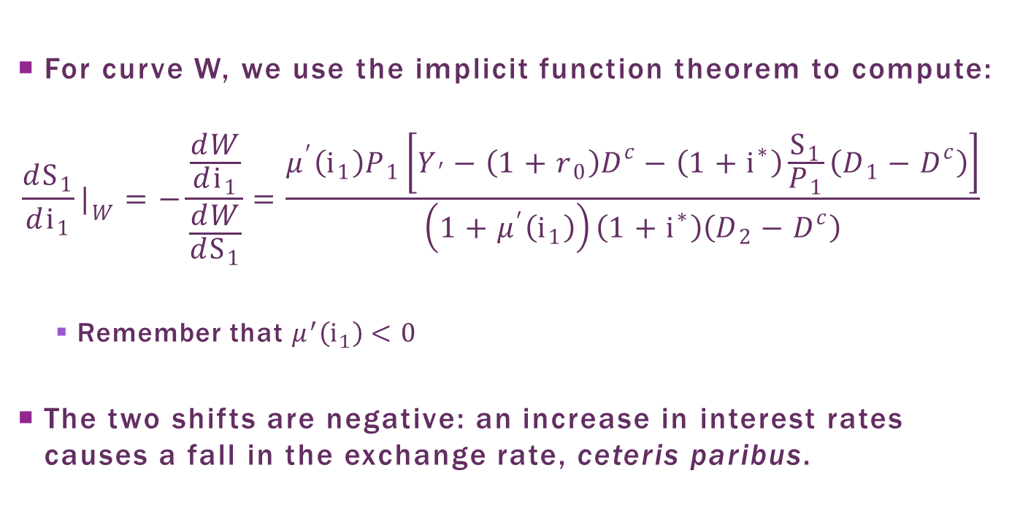
Optimal choice
For curve W, we use the implicit function theorem to compute:
$$\frac{dS_{1}}{di_{1}}|_{W}=−\frac{\frac{dW}{di_{1}}}{\frac{dW}{{dS}_{1}}}=\frac{μ^{′}\left(i_{1}\right)P_{1}\left[Y_{′}−\left(1+r_{0}\right)D^{c}−\left({1+i}^{∗}\right)\frac{S_{1}}{P_{1}}\left(D_{1}−D^{c}\right)\right]}{\left(1+μ^{′}\left(i_{1}\right)\right)\left({1+i}^{∗}\right)\left(D_{2}−D^{c}\right)}$$
  Remember that $μ^{′}\left(i_{1}\right)<0$
The two shifts are negative: an increase in interest rates causes a fall in the exchange rate, ceteris paribus.

Slide 83
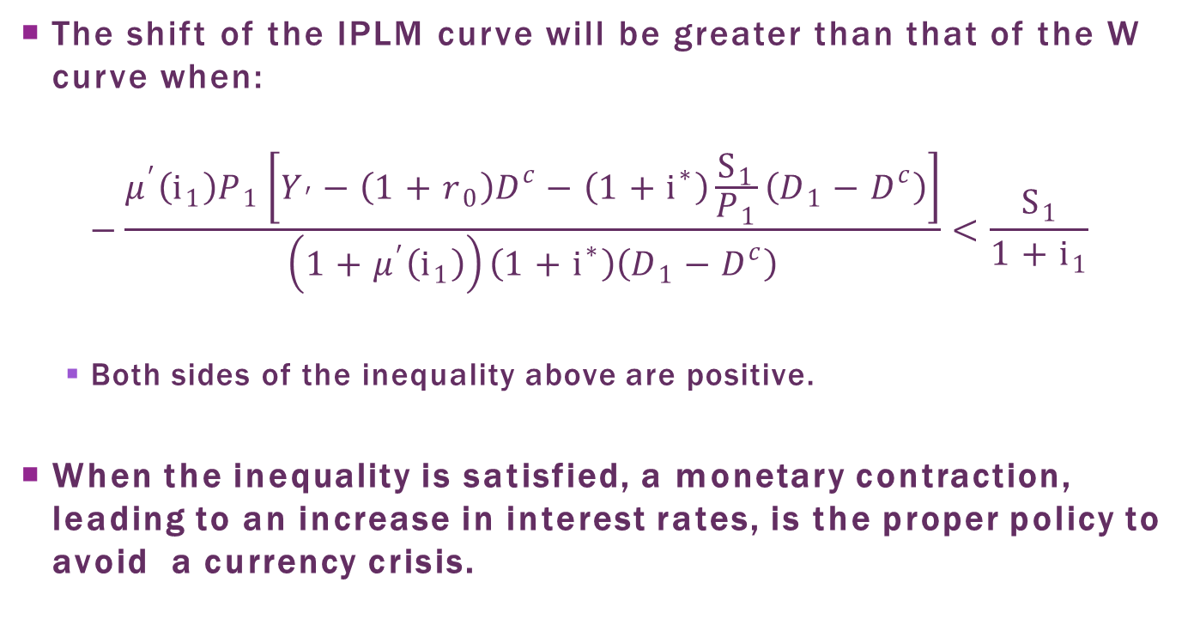
Optimal choice
The shift of the IPLM curve will be greater than that of the W curve when:
$$−\frac{μ^{′}\left(i_{1}\right)P_{1}\left[Y_{′}−\left(1+r_{0}\right)D^{c}−\left({1+i}^{∗}\right)\frac{S_{1}}{P_{1}}\left(D_{1}−D^{c}\right)\right]}{\left(1+μ^{′}\left(i_{1}\right)\right)\left({1+i}^{∗}\right)\left(D_{1}−D^{c}\right)}<\frac{S_{1}}{{1+i}_{1}}$$
  Both sides of the inequality above are positive.
When the inequality is satisfied, a monetary contraction, leading to an increase in interest rates, is the proper policy to avoid a currency crisis.

Slide 84
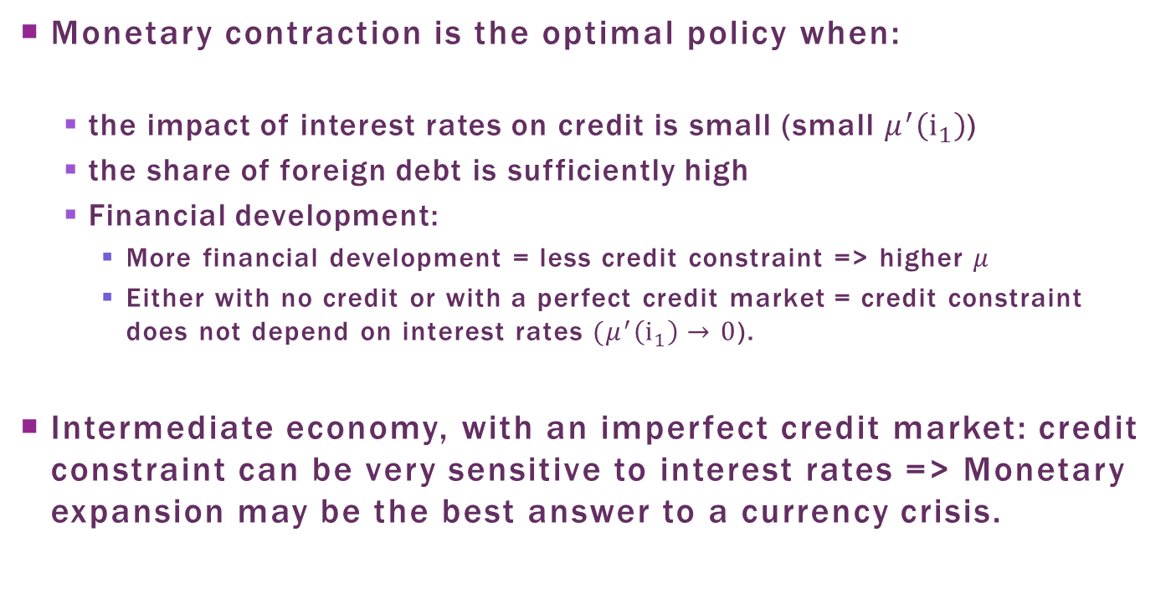
Optimal choice
Monetary contraction is the optimal policy when:
  the impact of interest rates on credit is small (small $μ^{′}\left(i_{1}\right)$)
  the share of foreign debt is sufficiently high
  Financial development:
    More financial development = less credit constraint => higher $μ$
    Either with no credit or with a perfect credit market = credit constraint does not depend on interest rates $(μ^{′}\left(i_{1}\right)→0$).
Intermediate economy, with an imperfect credit market: credit constraint can be very sensitive to interest rates => Monetary expansion may be the best answer to a currency crisis.

Slide 85
Plan
The Speculative Attack as Asset Price Arbitrage
Crises as Self-Fulfilling Prophecies
The Role of Banks and Foreign Debt
Contagion

Slide 86
Contagion
The Asian and Russian crises at the end of the 1990s had a profound impact on Latin American economies.
  Is there contagion in the propagation of shocks between economies?
Definitions of contagion:
  Is the probability of having a crisis in a given country affected by the fact of there being a crisis in another?
    Contagion due to interdependence between the economies.
  Is there a change in the propagation of shocks in times of crisis, compared to normal times?
    Factors associated with multiple equilibria (reversal in expectations or herd behavior).

Slide 87
Contagion: Trade
When two countries have a great deal of trade flow between them, the currency depreciation in one economy makes its more costly for the other to maintain its exchange rate parity.
This was the case between Argentina and Brazil in 1999.
When the Argentine government instituted the currency board regime in 1990, the 1:1 parity of the peso against the dollar seemed to yield the equilibrium RER.
  Average GDP growth 1991-1994 over 9%, no pressure on the ER.

Slide 88
Argentine Crisis
Tequila crisis 12/1994: after the Mexican crisis, international investors also became skeptical about Argentina
  Rise in interest rates and a financial sector reform: problem mitigated
Currency crises in Russia and Brazil 1999: the fatal blow.
  Depreciation of over 60% of the Brazilian real against the dollar = a depreciation of equal magnitude against the Argentine peso, given the fixed parity between the peso and the dollar
  increasing trade deficits with Brazil
  balance of payments crisis in Argentine

Slide 89
Contagion: Financial Market
Financial assets can also have an important role in contagion between countries.
Three possible channels
  Difficulty in obtaining information regarding a country => a herd behavior: investors follow the behavior of the better informed agent
  Investors hedge between markets, diversifying their portfolios. Crisis hits a country => investors reallocate their assets portfolios, selling riskier assets => propagation of crisis to other risky countries
  Crisis in one country => liquidity problem for investors => sell their assets in other countries where prices have not fallen => a fall in asset prices in other markets

Slide 90
Contagion: Unholy Trinity
Why does financial contagion occur in some cases and not others?
Kaminsky et al. (2003) identified three determining elements for contagion to occur: the unholy trinity
  abrupt reversal in capital flow (known as sudden stop);
  unexpected announcements; and
  a common creditor with leveraged assets.

Slide 91
Contagion in Latin America
Do Latin America countries suffer from contagion?
Transmission of crisis by financial panic, and other factors connected to multiple equilibria, does not appear to be significant. (Forbes and Rigobon, 2001)
Latin America presents episodes of lending booms followed by currency crises.
    The most probable cause of the crises is the combined financial liberalization effect combined with a deficiency in its regulation and supervision. (Gourinchas and Landerretche, 2001)

